Slide 1
Planning and executing a successful CT deployment of long TCP assembly
IPS – 15 - 9
2015 International Perforating Symposium
The Renaissance Hotel, Amsterdam
19th -21st May 2015
Charlie McClean
Baker Hughes

Slide 2

Background
The lower open hole completion had to be abandoned due to a screen failure resulting in sand breakthrough and sand to surface.
Notes:
The well had been shut in for considerable time with approximately 10 tones of sand.

Slide 3
Objective
Perforate an upper interval behind the 5 ½” production tubing and 7 ⅝” liner using 2.00” Intelligent coiled tubing
Perforate the well with base oil as the completion fluid, holding back pressure to control the underbalance.
Recover the gun system without killing the well.
Notes:
Critically perforate through the 5.5” & 7”

Slide 4
Why Intelligent Coiled Tubing?
Allowed deployment of entire 313 metre interval in one run.
Accurate depth control of the perforating assembly.
Concerns over sanding and rig time if wireline deployed.
Only the first run on wireline would be underbalanced.
Concerns over the reliability of tractors in this high debris environment.
Projected 7 days to perforate this interval with wireline.
It took less than 60 hours on coil.

Slide 5
Planning
Extensive modelling was carried out to ensure the coiled tubing could deploy and recover the gun system.

Slide 6
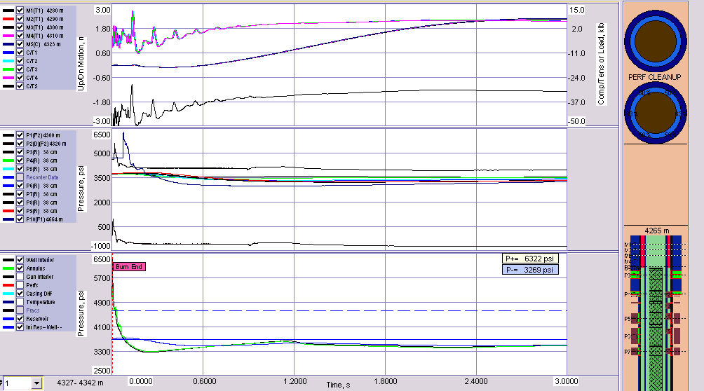
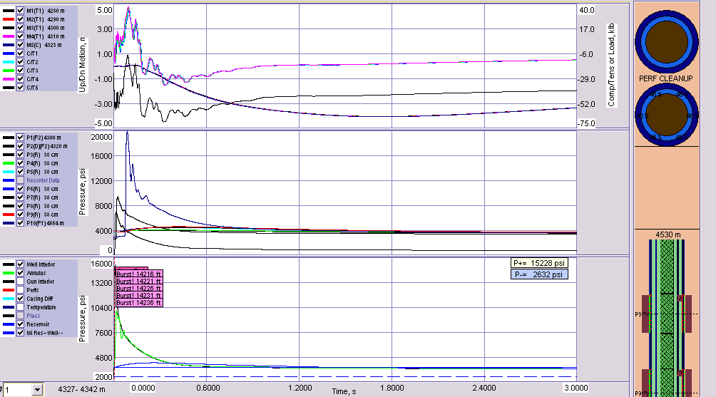
Planning
Gun shock on the coiled tubing was a concern, the assembly was modeled in a number of different scenarios to predict possible issues.
Hi speed data recorders were run with the job to validate the models.
Notes:
Sanding was also a concern due to the failed sand in the lower zone. Therefore, enhanced up from under-ballance modeling was also critical

Slide 7
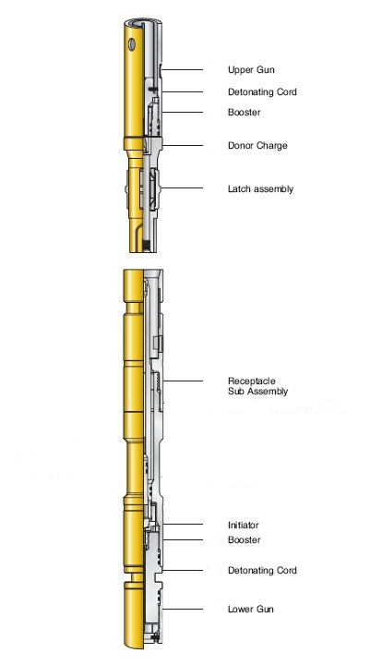
The Perforating Equipment
Standard wireline firing head with a swivel.
A PFC Gamma Ray/CCL tool for correlation.
An optional hydraulic time delay firing head.
3 ⅜” OD 6 spf 60°phased perforating guns
with high performance deep penetrating
charges
Live well deployment connectors to allow retrieval under pressure.

Slide 8
An HPHT Natural Completion
Debris Recipe to test the functionality of the deployment connectors
By Weight (with a total volume of 1400ml):
  50% Barite powder
  30% pipe dope (API 5A3)
  1% lubriplate hi-temp grease to simulate slickline ops
  1% WD40
  15% gravel pack sand (40/60) (representing formation sand)
By volume
  3-7% Swarf (fine strands of metal no more than 0.5mm in diameter, 20-25mm long)
Notes:
We performed two debris tests (with a third party witness present) on the SnapShot system using the same debris recipe under:
Realistic well conditions
Severe debris conditions which are unlikely to be encountered in real life situations
Testing was successfully completed in July 2011 with the SnapShot connector performing with no issues under both conditions.
Snapshot connectors were packed with debris and soaked in Barite overnight at 15kpsi, 450F, then loaded into the BOPs for pressure deployment functioning.
Worked VERY well. North Sea clients were impressed!
NOTE: there is NO industry standard ‘debris spec’. We created this recipe with input from North Sea client, to represent a horizontal intervention, non gravel-pack.

Slide 9
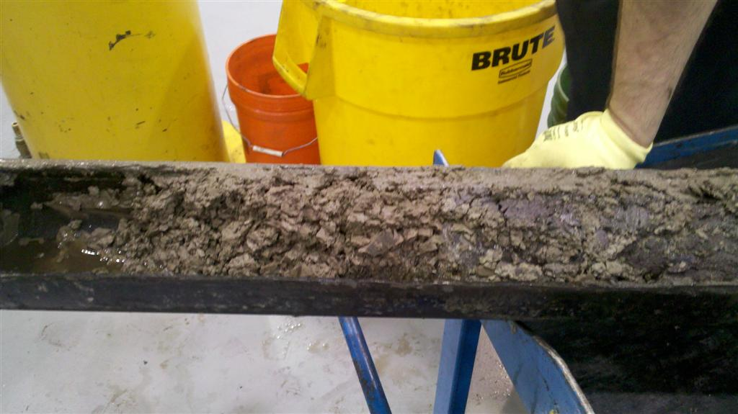
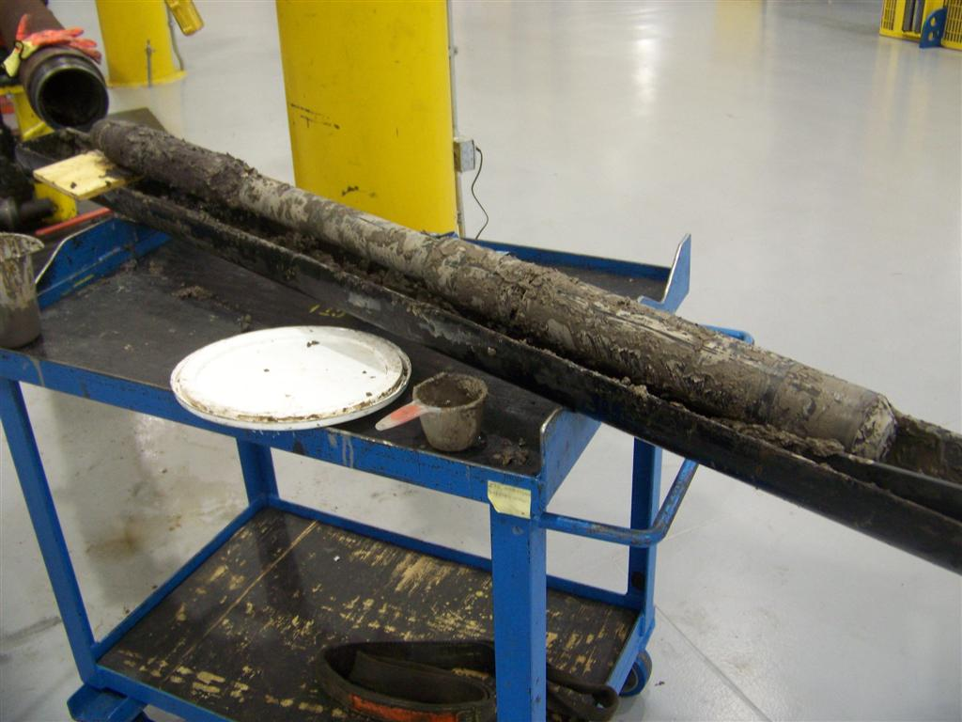
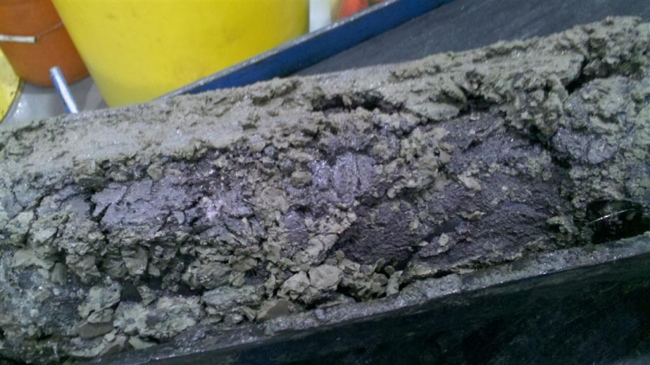
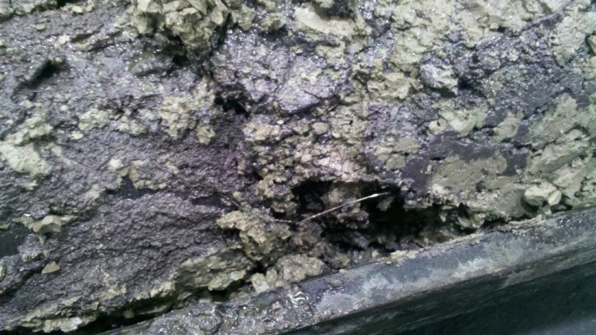
Realistic case, live well connectors are very robust, baked to 350° then functioned.
  Casing used in the oven
Notes:
“Realistic” conditions: debris packed from the outside, like in a real well situation.
“Severe” conditions: debris was injection-forced into the INSIDE of the connector, packing from the inside-out. VERY EXTREME!!!! Possibly un-realistic.
Connectors were packed with the solid debris, then soaked in a Barite bath overnight at 450F, 15kpsi.

Slide 10
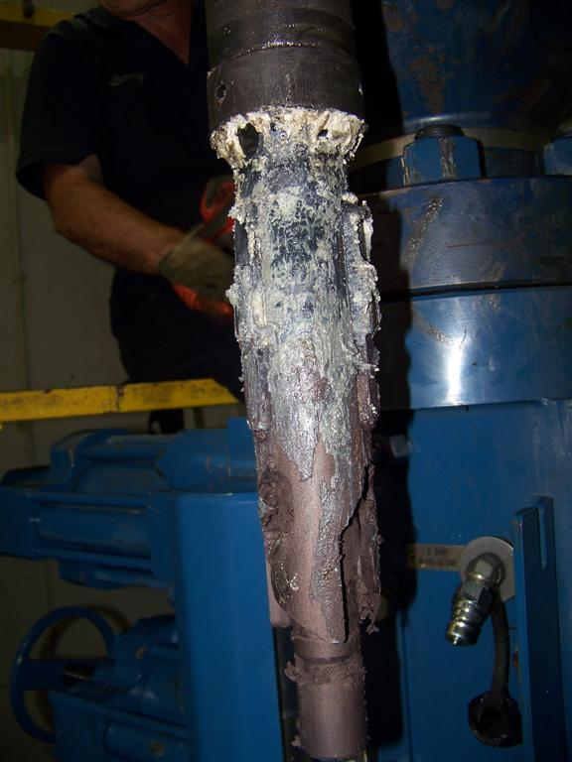
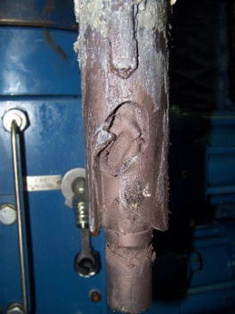
Latch subs after unlatching
  Realistic
  Well
  Conditions
  Severe
  Well Conditions
  j-slots are compacted with the debris mixture
Notes:
Photos showing the connectors after disconnect, aka POOH during un-deployment.
NOTE: each connector was disconnected, then RE-LATCHED ( still full of the goober-slobber debris) prior to removing from the BOP test assembly. This to represent disconnecting a gun section, and re-latching with a running tool prior to re-positioning gun section during reverse deployment procedures.
10

Slide 11
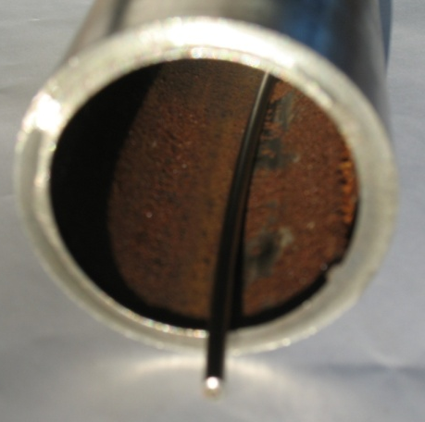
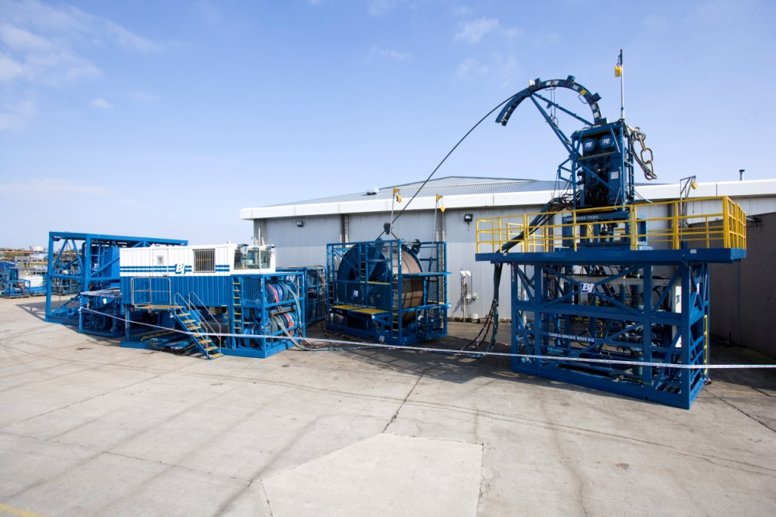
Intelligent Coiled Tubing
Communication system that allows direct electrical link to downhole tools to enable real time depth control.
Three main components:
  Intelligent coil wire and injection system
  Surface equipment for data recording and display
  Coiled tubing

Slide 12
Typical Coiled Tubing Surface Stack
COILED TUBING INJECTOR HEAD
STRIPPER
QUICK CONNECT SUB
COILED TUBING BOP
FLOW TEE & RISER SECTIONS AS REQUIRED
GATE VALVES x 3 c/w EQUALIZING JUMPER HOSES
DEPLOYMENT BOP
COILED TUBING SHEAR / SEAL BOP
WELLHEAD XMAS TREE

Slide 13
Deployment BOP
Disconnect Ram
No-Go Ram with Internal Lock Ram

Slide 14
Deployment BHA
COILED TUBING BHA
FLUTED CENTRALISER
SWIVEL
DEPLOYMENT LATCH SUB
Notes:
Swivel is essential to allow the latch to J in to the receptacle. A bumper sub can be used in the deployment BHA

Slide 15
Gun Connector
LATCH SUB
LATCH KEY ASSEMBLY
AUTO J - SLOT
RECEPTACLE
LOCK GROOVE
RAM SUB

Slide 16
Deployment Sequence
Rig Up 1st assembly.
Stab on, equalize and tag stripper
Open Xmas Tree Valves. Open Gate Valves. Open BOP Rams.
Notes:
Rig up 1st assembly, stab on, pick up tag stripper, open tree valves, open gate valves.

Slide 17
Deployment Sequence
RIH with 1st Gun Assembly & position mid Ram Sub across the No-Go Rams
Notes:
Position 1st assembly with the Mid-point of the ram sub in the no-go rams using the dimensions planned in the deployment matrix sheet.

Slide 18
Deployment Sequence
Close No-Go Rams around Ram Sub. Observe rams fully closed.
Notes:
Using the sequence in the matrix sheet start to use the BOP’s to function the system. Using the ram tell-tails to confirm full stroke of the ram.

Slide 19
Deployment Sequence
Verify correct positioning by picking up on CT and performing a pull test. Check CT depth tallies with pre-calculated deployment depth.
Notes:
The over pull for pull test should be between 3k-5klbs. Using the matrix as a step by step and dimensional guide.

Slide 20
Deployment Sequence
RIH with CT and set down weight on the No-Go Rams. Check CT depth tallies with pre-calculated deployment depth.
Close Internal Lock Rams
Close Manual Locks.
Notes:
Manual locks can be used to unsure that the rams will not open accidentally. And for duel function rams will allow the pressure to be increased.

Slide 21
Deployment Sequence
Close Disconnect Rams. Pick up on CT and confirm clear.
Notes:
Once the disconnect ram is closed the tool should be free to pull out.

Slide 22
Deployment Sequence
CT POOH & Tag the Stripper.
Open Disconnect Rams.
Notes:
Follow deployment matrix

Slide 23
Deployment Sequence
Close Lower Gate Valve.
Notes:
Follow deployment matrix

Slide 24
Deployment Sequence
Bleed down WHP above Lower Gate Valve.
Notes:
Follow deployment matrix

Slide 25
Deployment Sequence
Close middle Gate Valve.
Break out at Quick Connect Sub & prepare to run next assembly.
Stab on Injector Head. Perform pressure test on Quick Connect Sub. Confirm CT tagged and counter zeroed.
Notes:
Follow deployment matrix

Slide 26
Deployment Sequence
Equalize WHP across Gate Valves & Riser using Jumper Lines.
Notes:
Follow deployment matrix

Slide 27
Deployment Sequence
Open Gate Valves.
Notes:
Follow deployment matrix

Slide 28
Deployment Sequence
CT RIH & latch into Receptacle . Check CT depth tallies with pre-calculated latch depth.
Open Internal Lock Rams.
Notes:
Follow deployment matrix,

Slide 29
Deployment Sequence
RIH to position mid Ram Sub across No-Go Rams.

Slide 30
Deployment Sequence
Confirm successful latch by picking up & performing a pull test against the No-Go Rams. Check CT depth tallies with pre-calculated deployment depth.

Slide 31
Deployment Sequence
Open Manual Locks. Open No-Go Rams.

Slide 32
Deployment Sequence
RIH to position next connector across No-Go Rams.
Repeat steps until all assemblies are deployed & hanging off in the BOP.
Notes:
Continue to follow deployment matrix. Making sure to always mark on the action taken and to take pull tests at the correct stage of the operation.

Slide 33
The Job
Dead well deployment with rig, barriers in place
A gun connector on every other gun body.
The snap latch feature reduced run time significantly, 3 hours to deploy 313 metres of guns.
PFC used for real time depth correlation of the perforating assembly.
Good indication of gun detonation, perforating string pulled up hole before tubing pressure bled down to prevent sand issues
Wellhead pressure increased to 1,450 psi.
Assembly recovered in 48 hours with all shots fired and no damage to the coiled tubing as predicted by the computer model.
Well was placed back on production.

Slide 34
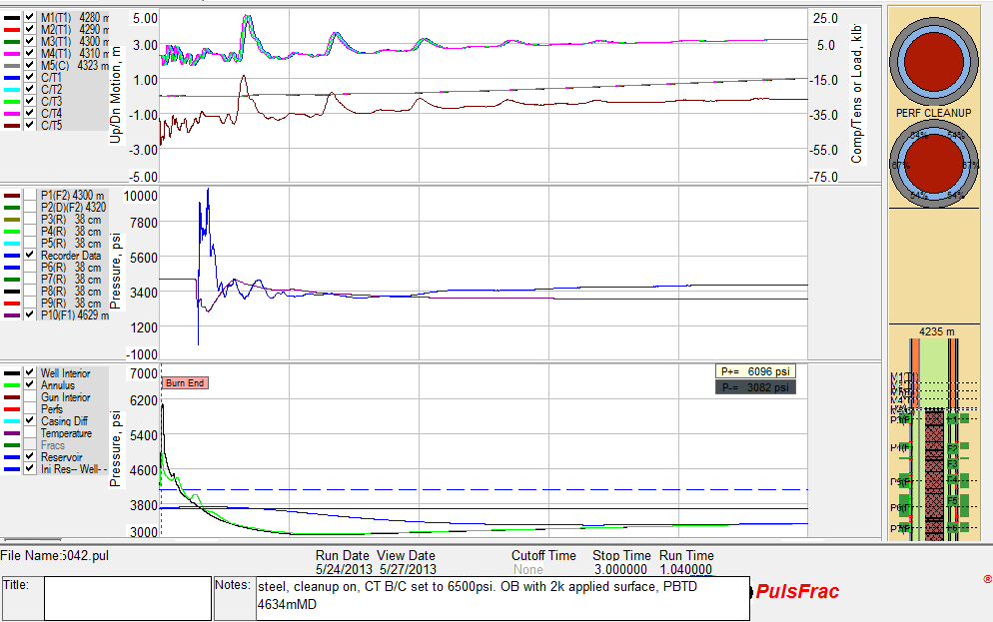
High Speed Recorder Data Overlay

Slide 35
When permeability and skin were adjusted the overlay was very accurate

Slide 36
Conclusion
Deployment of long gun strings on 2.00” intelligent coil is a viable alternative to wireline or tubing conveyed perforating
Modeling the job is a must and can help mitigate risk
High speed recorders are excellent tools for model validation.
Deployment connectors allow the safe recovery of long gun strings without killing the well, thus maintaining productivity.

Slide 37
Acknowledgements / Thank You
Parry Hillis: Technical Manager Baker Hughes
David Ayre: BP Well Perforation Specialist
Jim Gilliat, BDM Baker Hughes
Management of BP & Baker Hughes Incorporated for supporting this study.
International Perforating Symposium Europe

Slide 38
Slide 38
Questions ?

