Slide 1
Case Study: Live Well Deployment System in Brunei – Challenges and learnings
International Perforating Symposium Europe 2015
Amsterdam
Authors: S. Sulaiman, L.S. Loong, Y. Song, Y. L. Ming, M. S. Brinsden (Shell),
W. Tapia (SLB)
Notes:
1

Slide 2
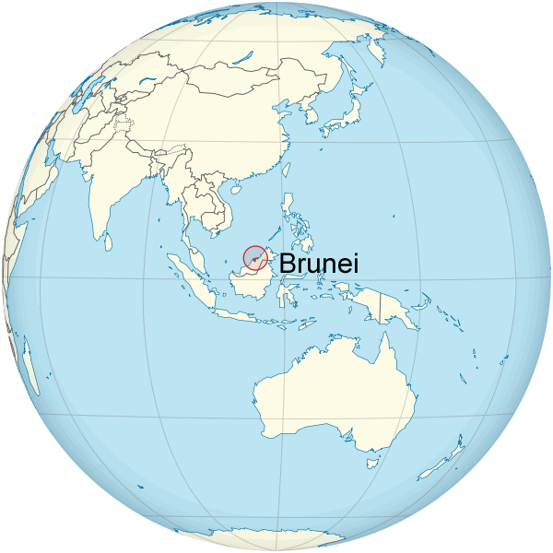
Agenda
Background
Objectives
Why “live well intervention” system?
Model
Operational summary
Challenges & Mitigation
Learnings
Conclusions

Slide 3
Background
Well Schematics
The well was completed & kicked off on 25th Dec 2014
  With only bottom reservoir perforated due to big pressure differentials with zone above (risk of differentially sticking and crossflow)
The base plan was to add second perforating zone on the 8.5” section once the pressures have equalized with the existing perforation.
Post drilling volumes and pressures indicate that it would take 3 months production to deplete current deep sands to same pressure as second perforating zone.
As per April 2015, downhole pressure gauges suggested the pressures had equalized and the well had condensate banking issue.
The job was carried out in mid April to perforate the new target sands.
Well Specs
Mono string 4.5” tbg
High pressure gas
No sand control
13Cr tubing
15K wellhead
Min ID = 3.903”
New Perf
Pr = 8.5Kpsi
2-7/8” 60deg 6spf
Existing Perf
Pr = 9.3Kpsi
TD = 5084 mMD
21 May 2015
3
Notes:
3

Slide 4
Objectives
To add second perforating zone without killing or damaging the existing zone
Optimize recovery by perforating at optimum condition to prevent cross-flow
Justification
Live well intervention system was chosen due to gross perforating interval of 330m and not having to kill the well with Caesium formate (~ USD10 mil).
Notes:
4

Slide 5

Why “Live” Well Intervention System?
The Good
  Insert and retrieve gun strings under wellhead pressure
  Perforate a long interval (without length restriction on riser/PCE/lubricator)
  Allow optimum perforating conditions (DUB) without exposing the formation to damaging kill fluids.
  Perforate multiple runs without killing the well between runs.
  It allows deployment of the firing head separately from the gun.
  Accidental activation of the head while it is pressurized would be harmless as it is not connected to the guns at this time
  Downhole Real Time data acquired using Fibre Optic Enabled Coiled Tubing allows to ensure to correlate the perforation depth and activate the firing head properly.
The Bad
  Inherently a high risk and complex operation, anything can go wrong and lead to disaster due to “live well”
  Time consuming especially with drilling rig support
Notes:
5

Slide 6
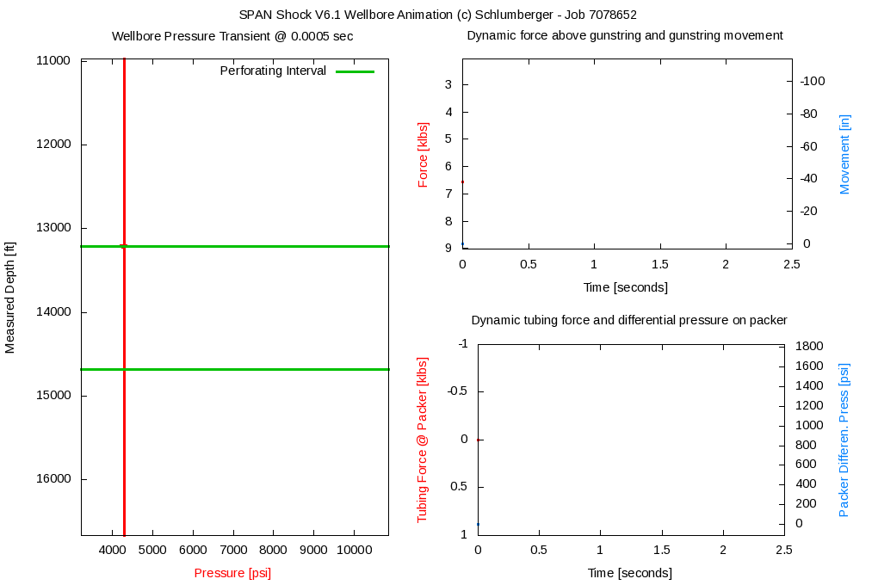
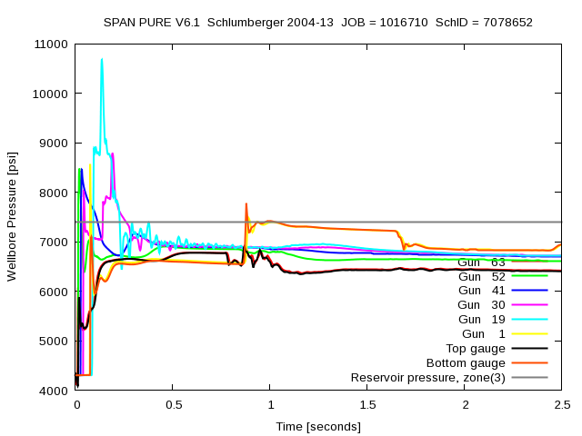
Model – Gun Shock Dynamics
SPAN shock/ Pulsefrac models suggested the job can be done in one run (worse case)
Due to unknown fluid type and level, different scenarios modeled; worse case is the string is moving upwards over 100” – however still within CTU limit and no warning
Models cannot be calibrated because the fast response gauges was not available and the job was not executed as per what was modelled.
Perforating Shock pressure dynamics – 4300 psi Wellbore pressure / Well Bore Fluid Column of water to 3,344m MD / 3052m TVD – Gas above fluid column
Notes:
6

Slide 7
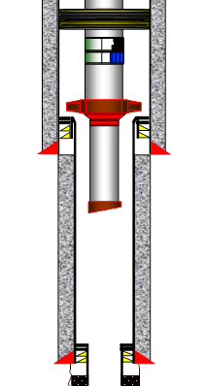
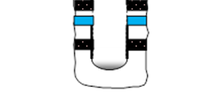
Model – T&D
T&D suggest to perforate the 331m net interval in 2 runs:
  Perforating gun #1 was using “live” gun deployment to perforate 91m interval;
  Perforating gun #2 was using “live” gun deployment to perforate 240m interval;
The T&D was not cross checked with in-house’s T&D for CTU.
Live perforating gun #1
Live perforating gun #2
Before Fire
Full of gas
On balance
After Fire
Full of gas
WHP = 7520psi
Before Fire
Full of formation water
500psi Static UB
WHP = 2600psi
After Fire
Fluid level went down
Gas in wellbore
WHP = 6500 psi
Gun lengths
Gun #2 = 240m
Spacer = 120m
Gun#1 = 91m
Notes:
7

Slide 8
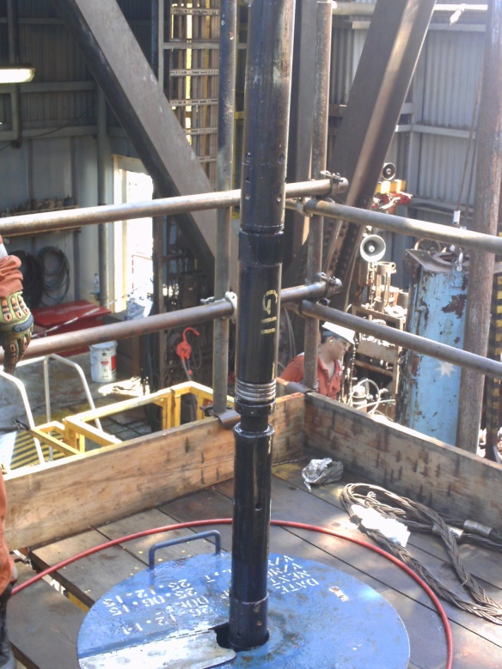
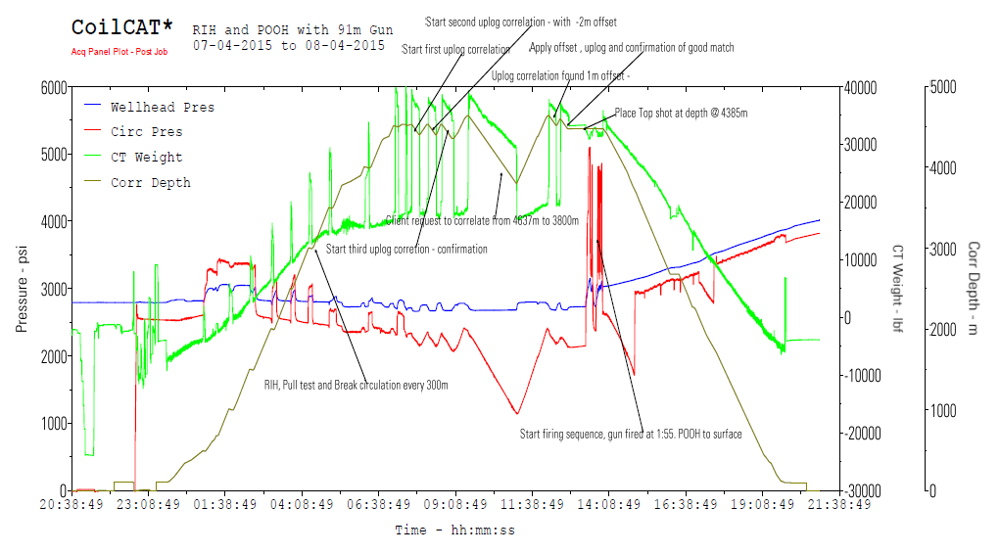
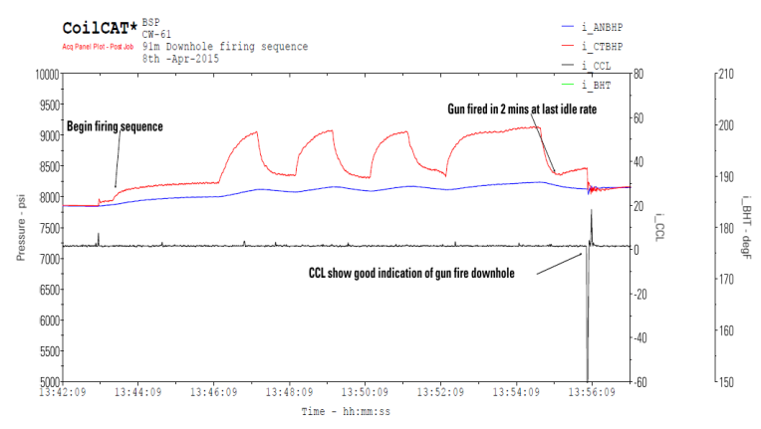
Operation Summary
Depth was correlated using gamma rays and CCL
Firing was activated by pumping rate pressure cucles, fibre optic was used to ensure proper signals are passed onto the FH.
All the guns were successfully activated, and the parameters were followed in real time with the downhole sensors in the CT BHA.
Many problems were encountered:
  Barriers leaked: swab valves, UMV, plug valves. All were rectified.
  Guns was overpulled (10,000lbs). UMV was closed against the gun carrier. Retrieved and change with new gun.
Notes:
8

Slide 9
Challenges
Estimated Maximum CITHP = 7200 psi (close to 10K system recommended limit of 8500 psi)
First time such operations carried out in BSP. In similar operations by another Operator in Brunei and a Shell operating unit in Malaysia, they dropped the guns in hole – suspected due to miscommunication between CT & gun deployment crews and the difference in the sensor measurements and the actual weight applied in every CIRP connection.
Suboptimal CTU size used. The crane capacity just allowed to lift a maximum weight of 33.5 MT which represented that it was necessary to use a 1.75” CTU string which had to be trimmed and purged before sending offshore (PTE advice is to use 2” coil)
There was not enough space in the Cantilever deck to set the Reel, Control Cabin and Power Pack on it. Hence running long cables for the electronic system and extended hydraulic hoses were required to operate the unit from the main deck that caused delay in respond to the system.
Because continuous and multiple high pressure test to be done, a big quantity of spares had to be sent to location in order to have enough resources on board, which represented to keep a good coordination between the crew offshore and Town throughout the operation.
The Fiber Optic inside of the CT string run very close to its temperature limitation ~ 250degF, for this reason it was important to monitor constantly the real Downhole data to apply any mitigation to reduce the temperature during this intervention.
Notes:
9

Slide 10
Improvements/ Mitigations
Contractor’s models were crosschecked against Pulsefrac. The 1.75” pipe is right on the edge of the maximum lifting capacity. This size of coil also was supported by the simulations made to check feasibility to run at least 500m of guns under gas conditions
Adopted many drop the guns preventions steps into the SOP, the main ones were:
  Using Tension Compression tool in ACTive BHA to see if the correct weight or pull are applied to confirm the connections was done properly.
  Using a Zone 2 LCD screen close to the TDS system in order to allow the TCP guys to check the parameters (weight mentioned above, WHP, Circ. Pressure, etc) in real time during each connection
  Some modification done to the procedure for improvement (not standard to CIRP). Main things on the PCE setup, equipment layout, Pressure test procedure, bleed off procedure, well control contingency incorporate in program.
  Many other SOP had to be generated for non-routine task, especially the procedure to lift the injector head through the A-frame of the derrick to align it with the well, Stab in the CT into the Injector Head, follow up all the steps during all the CIRP connection
model
procedure
Notes:
10

Slide 11
What went wrong?
Leaking gate valves: more back up gate valves have to be sent to keep them as contingency
The CT BOP pressure test frequency required by PCM is 15 days however the contractor standards require every 7 days, this must be aligned and assessed properly during the planning period
Leaking swab and UMV: ensure Xmas tree valves are greased prior to any well intervention activity/ ensure scheduled maintenance was performed.
Leaking plug valves: even thought the plug valves of the treating iron were tested before loading out, it is necessary to check properly the seals used and inspect the way how this test is being done.
Condensate contaminated brine accumulation in the trip tank: while reverse deploying post perforation gun #1, this was not captured in the program, ended up injecting clean brine to clean up the contamination.
Deviations from program: shear pin settings on the circulation sub was changed without informing Company Rep.
Logging program: The decision kept on changing. The instruction given was also confusing to which depth parameter to be used (gamma ray depth, CCL depth, Tool end depth) was not clear.
barrier
program
Notes:
11

Slide 12
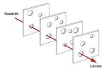
Conclusions
Extensive job preparations including trial rig up with running & pulling practices on a training-well onshore help crews to execute job better.
Zones of interest perforated with “live” well intervention system as planned, despite high risk operational hiccups.
Job execution operationally more challenging than expected. Took ~17 days (Including an extra run to set a bridge plug in the 4.5 liner with CT) compared to 10 days planned. Make-up & deploy average of 1.3 guns per hour. Initial estimate was to be able make-up & deploy up to 4 to 5 guns per hour.
Flow performance still under evaluation – ongoing clean up stage.
On the flip side, many thing had gone wrong (hi-potential incidents) but we are lucky this time they didn’t line up:
barriers
programs
HAZID
LFI
Notes:
12

Slide 13


