Slide 1
2015 International Perforating Symposium
The Renaissance Hotel, Amsterdam
Tuesday thru Thursday, May 19-21, 2015
IPS – 15- 21
Innovative Flow Through Perforating System
Stephen Zuklic, Baker Hughes
Stan Hilligiest, Baker Hughes

Slide 2
Flow Through Perforating System Discussion Topics
IPS – 15- 21
Categories of perforating methods
Benefits and challenges of each method
Flow Through Perforating System solution – Case history
System function
Technical Summary
Q&A

Slide 3
Standard Tubing Conveyed Perforating (TCP) Methods
IPS – 15- 21
Shoot and Pull
Shoot and Drop*
Extra rig time to pull assembly
Formation damage from fluid loss and LCM’s (reduced productivity)
Increased well control risk
Higher completion fluid costs
Requires drilling extra rathole (time and cost)
Not viable in
  horizontal wells
  long intervals
  zones just above pressure transitions
  uphole recompletes with tight spacing
  *Permanent
Guns are run below the final completion assembly, and after detonation fall into the rathole to allow production
If rathole isn’t available to accept spent guns, assembly must be pulled prior to running final completion assembly
Rathole

Slide 4
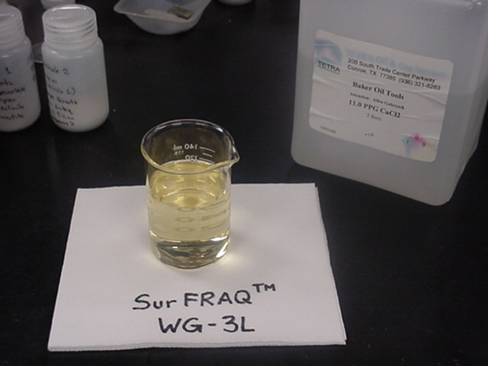
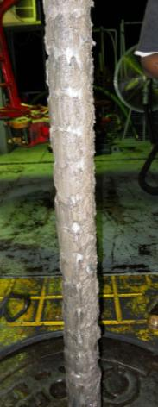
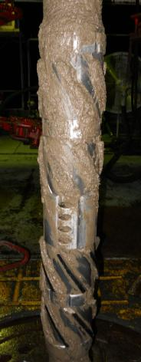
Variations in Field Conditions versus Lab Conditions
IPS – 15- 21
Kill Weight Fluids and LCM Challenges
Completion fluid filtration
Wellbore clean-up
Rig mixing capabilities
Pill storage concerns
Pill agitation
High temperature challenges
Notes:
Examples of LCM in lab environment along with displacement tools after a poorly performed wellbore displacement and clean-up. If the clean-up strategy is executed correctly, say an effective static and or dynamic underbalance is used, the well should take fluid after perforating. Any debris in the wellbore, whether left in the casing after a poorly performed clean-up or introduced into the wellbore during perf clean-up, can be carried back into the perfs with the losses and LCM. Additionally, mixing and storage issues with LCM can reduce its effectiveness and further reduce return perm. Therefore the optimum scenario is to completely eliminate fluid loss and the need for pills.

Slide 5
Flow-Through System Benefits
IPS – 15- 21
Allows installation of entire completion prior to perforating interval(s)
Eliminates cost and time associated with drilling rathole
Eliminates production impairment from fluid loss and LCM damage
Eliminates cost and risk of live well deployment (and undeployment)
Radically changes completion procedures (and cost) on many long intervals in subsea environments
Guns and firing system internals “disappear” to allow unrestricted flow of production without pulling guns

Slide 6
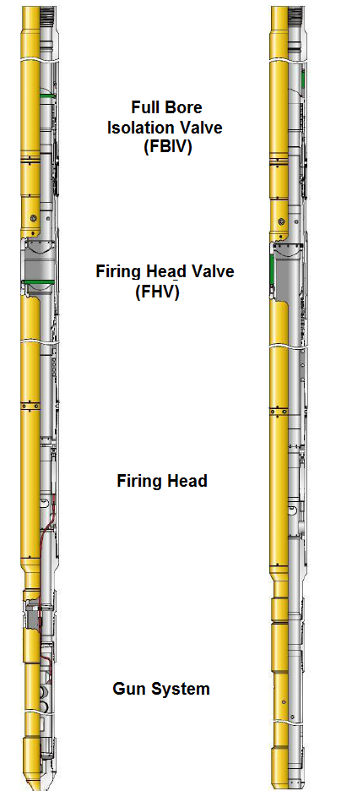
FTPS: System Function
IPS – 15- 21
FBIV: acts as packer setting device and includes lower end to open a fluid path to gun valve / firing system after FBIV opens (this “arms” the system)
FHV: isolates internal explosive components from wellbore fluid; unlocks with firing pressure and drives firing pins in head; fully opens after detonation
Firing head: contains firing pins, initiators and time delay fuses that initiate detonating cord to guns; arranged concentrically for open ID
Gun system with disappearing charge tube and retention systems.
Pre-Detonation
Post-Detonation

Slide 7
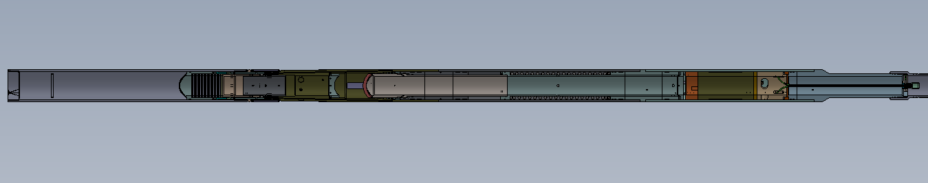
FTPS Upper Assembly
IPS – 15- 21
Firing Head Valve (FHV)
Firing Head / Blank Gun Adapter
Full Bore Isolation Valve (FBIV)
Firing Head

Slide 8
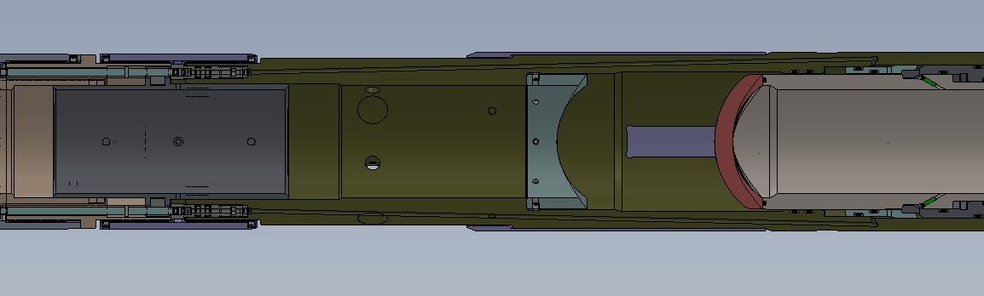
FTPS Function Discussion—Primary Actuation
IPS – 15- 21
Gun drill for fluid by-pass to primary unlocking mechanism
Pins pull back
Rupture discs (2 primary, 1 secondary)
Locking ring pushed up by fluid, allowing lock ring to release mandrel
After FBIV opens, primary pins pull back, allowing fluid to be exposed to rupture discs; once discs burst, fluid goes through gun drills and unlocks gun valve mandrel

Slide 9
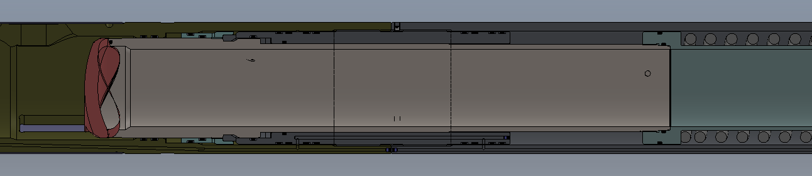
FTPS Function Discussion—Primary Actuation
IPS – 15- 21
Wellbore hydrostatic
Power spring is compressed
Piston area of entire gun valve flapper pushes gun valve mandrel down (power spring pushes mandrel upward but is easily overcome by piston area since below flapper is atmospheric pressue)
Notes:
Note
Intention is to have modular presentation. The General Approach section (intended to be in keeping with the payzone approach for completions) should serve as a background for any sub-strategy presentation.
Can unhide and modify this slide. Full contents are:
Market / Financial Background
Approach
Product and Service Development
Planned Growth Timeline and Financial Bridge
Applied Perforating Science Plan
Product/Service Naming Plan

Slide 10
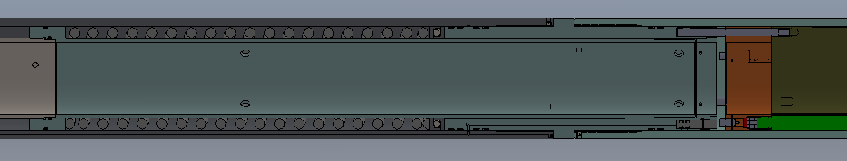
FTPS Function Discussion—Primary Actuation
IPS – 15- 21
Gun valve mandrel strikes firing pin ring, driving 2 primary firing pins into the time delay fuses. Each fuse ignites detonating cord into a 3-to-1 receiver booster. (train also detonates “backwards”—if any of the 3 cords detonates, the other two trains are detonated so no live explosives remain).
Notes:
Note: Here is Marks

Slide 11
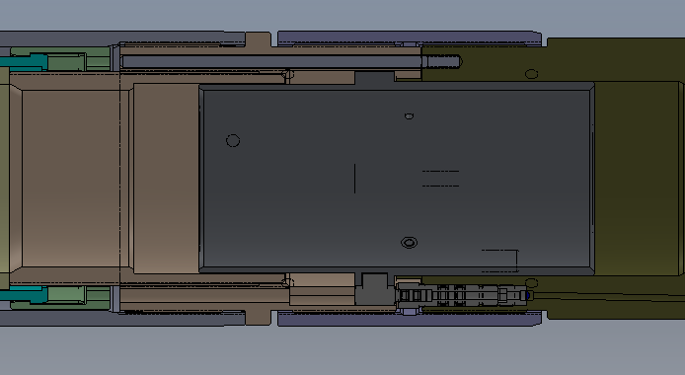
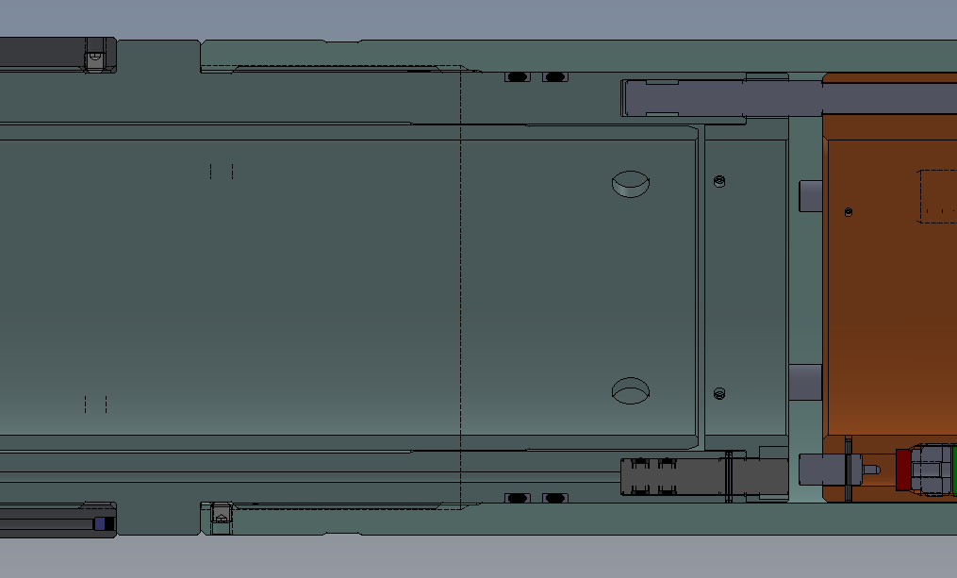
FTPS Function Discussion—Secondary Actuation
IPS – 15- 21
Wireline / coiled tubing shifting tool can be used to shift the internal sleeve up. This pulls up the 3rd (secondary) isolation pin, exposing the rupture disc that blocks the gun drill path all the way through the gun valve, down to the secondary firing pin. Note: the rupture disc can be selected to allow removal of the wireline tools before pressuring up to fire. Secondary pin remains pinned and ready to fire regardless of whether primary ring has been moved.
Notes:
Note
Intention is to have modular presentation. The General Approach section (intended to be in keeping with the payzone approach for completions) should serve as a background for any sub-strategy presentation.
Can unhide and modify this slide. Full contents are:
Market / Financial Background
Approach
Product and Service Development
Planned Growth Timeline and Financial Bridge
Applied Perforating Science Plan
Product/Service Naming Plan

Slide 12
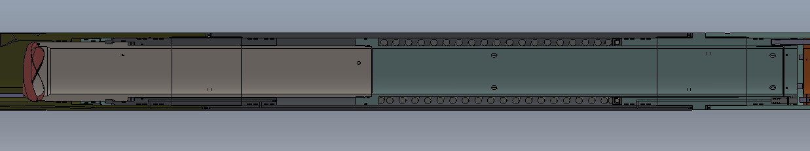
FTPS Function Discussion—Primary Actuation
IPS – 15- 21
Gun gas and fluid pressure entering guns alleviates the differential against the gun valve flapper, and allows the spring to drive the mandrel back up, opening the flapper and “hiding” it behind the tube to create a smooth through-bore.

Slide 13
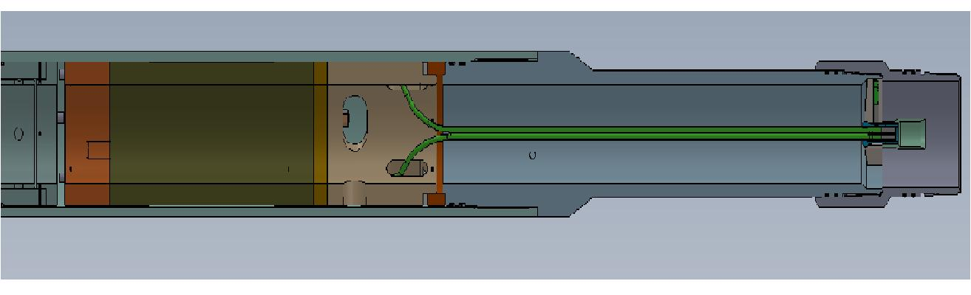
FTPS: Firing Head Components
IPS – 15- 21
Notes:
The firing head module contains three detonation paths; two primary and one secondary, providing the highest degree of reliability.

Slide 14
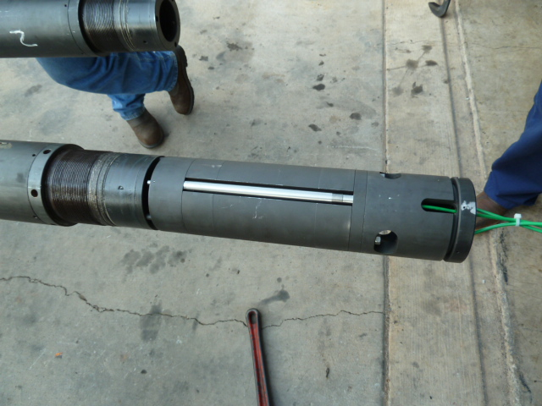
FTPS: Firing Head Components
IPS – 15- 21
Notes:
One of three pyrotechnic time delays. Spaced at 120°

Slide 15
FTPS Gun Components
IPS – 15- 21

Slide 16
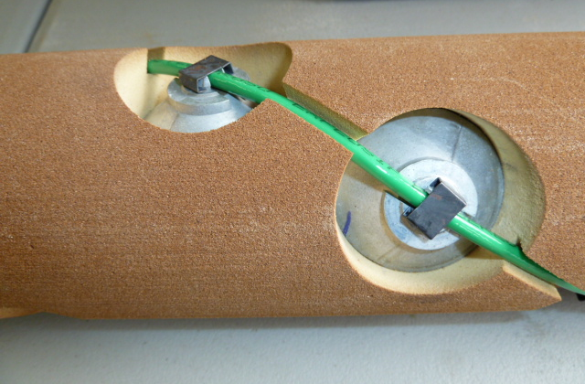
FTPS: Charges and Charge Tube
IPS – 15- 21

Slide 17
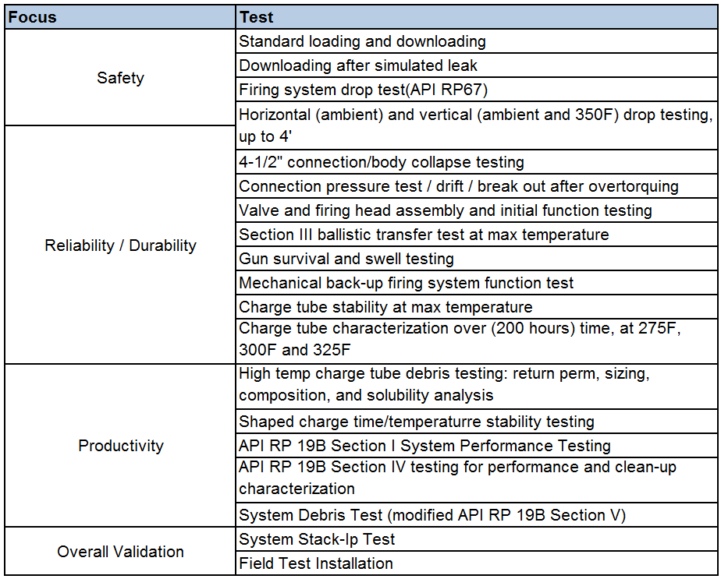
Lab and Ballistics Range Testing
IPS – 15- 21
Notes:
An extensive battery of tests was performed to validate system performance against key drivers. Many of the tests are standard for any gun system, but some were based off of the approach of considering potential issues. For example: considered potential leaks in the system or partial firing and how it affected downloading; looked survival for a variety of metallurgies; considered low debris charge performance for extended time frame.
Again, looking at the system in terms of potential issues: back-up firing system, vertical drop tests (simulate running into a liner top), drop testing at temperature.

Slide 18
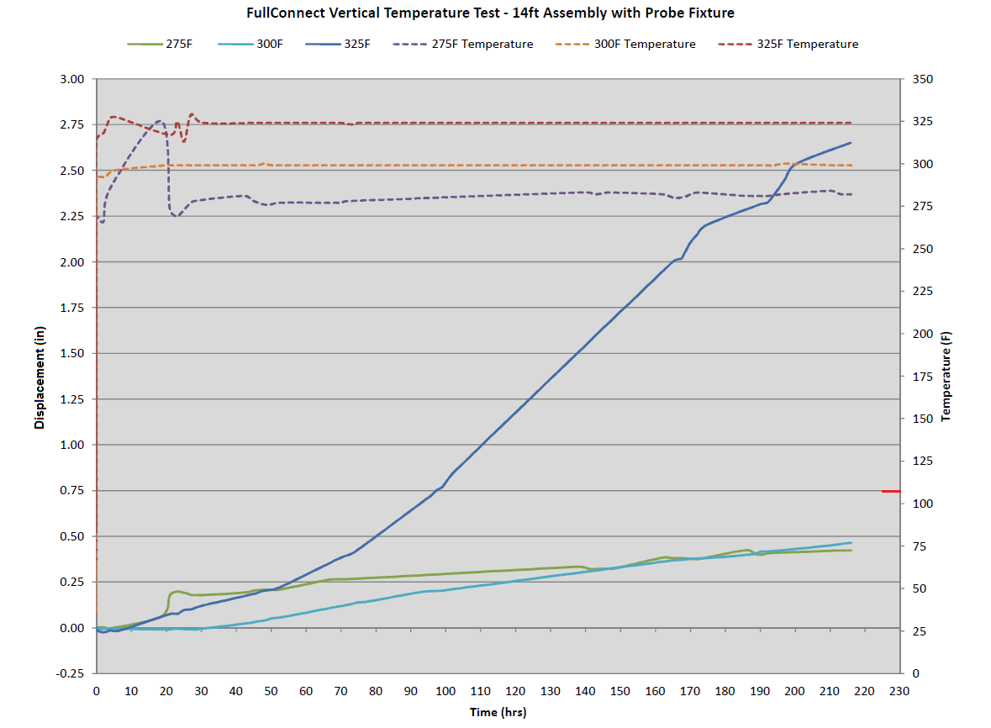
Charge Tube Time/Temp Response – Composite Data
IPS – 15- 21
Notes:
Further testing was conducted to more precisely define the time/temperature operational envelope. This chart demonstrates the physical response of the charge tube at three temperatures 275°F, 300°F, and 325°F. All three time/temperature tests were conducted with the fixture which allowed monitoring of movement, or displacement of the foam charge tube throughout the test.

Slide 19
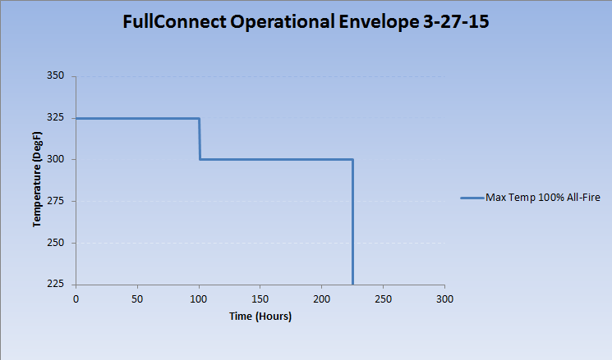
Time/Temperature Operational Envelope
Notes:
The time/temperature test data was compiled to create an operational envelop of the system. The graphic here shows the current operational envelope of the FullConnect system. Empirical data confirms system capability under the blue curve.

Slide 20
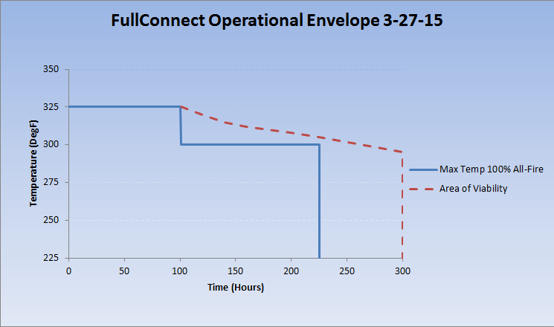
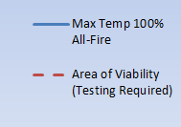
Time/Temperature Operational Envelope
IPS – 15- 21
Notes:
The area beyond the blue curve and inside the red curve was established based on (conservative) extrapolation of the test data. We feel that this is a viable area for candidate wells, but would require testing to confirm.

Slide 21
Proof of Concept
IPS – 15- 21
System Validation – October 19, 2012

Slide 22
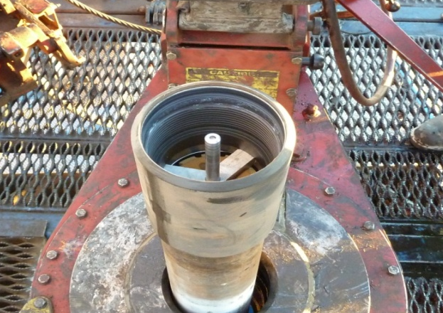
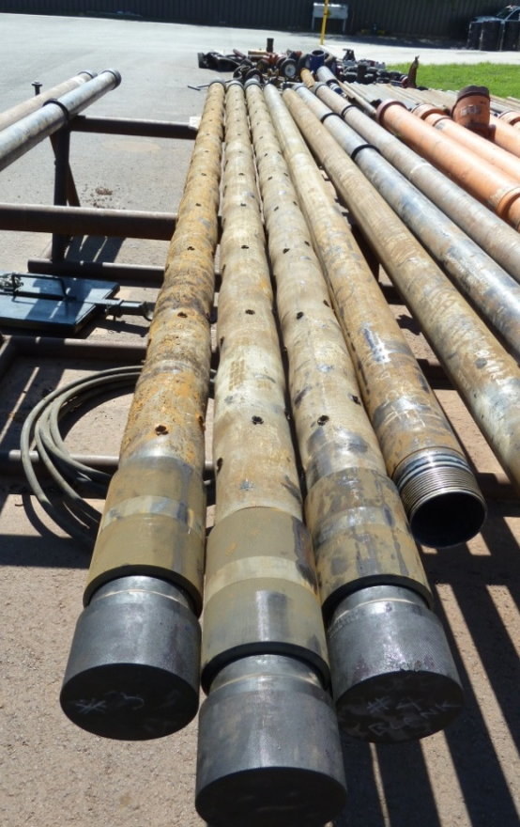
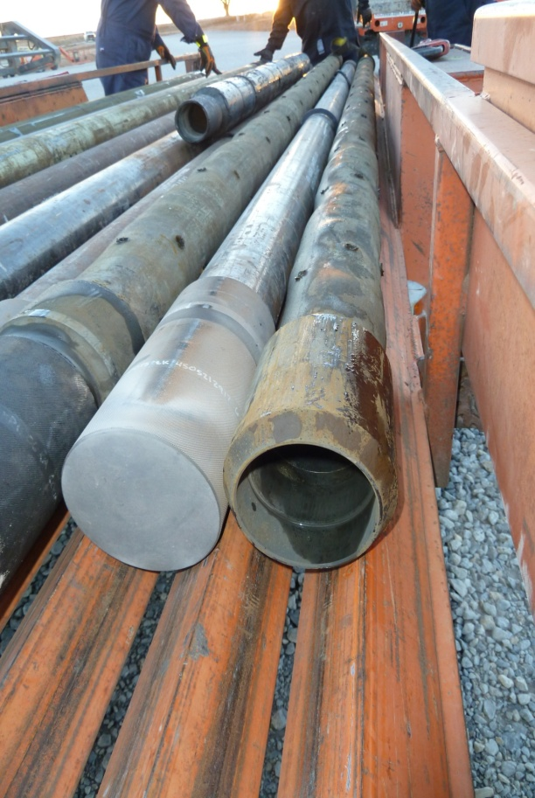
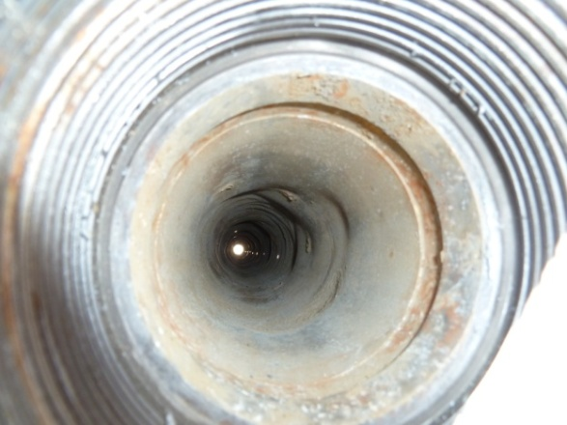
Qualification Testing – Case History
IPS – 15- 21
Field demonstration test completed on October 19th 2012
  3 loaded 14ft guns, 2 blank, 5,300ft TVD
  No debris recovered, all shots fired OK

Slide 23
Controlled Field Test
IPS – 15- 21
Well Environment
Openhole water injector (carbonate)
7” casing, 6” openhole
~2,500 psi BHP / ~140F BHT
~5200’ TVD (vertical)
8.5 PPG freshwater completion fluid
Perforating System
Shoot and pull application
Retrievable hook-wall packer
Spacer tubing
Multi-cycle initiation valve
Gun valve (fluid barrier)
Redundant hydraulic firing head
Gun system (4-1/2”)
  28’ blank safety spacer (2 guns)
  42’ loaded guns (5 SPF, 39grm deep penetrator)
  Blow-out bull plug
Notes:
The well environment was fairly benign in the initial field installation. Because a visible validation of function was desired, the system was retrieved from the well immediately after firing rather than remaining in the well as would normally be the case.

Slide 24
Controlled Field Test
IPS – 15- 21
Operational Sequence
Ran bit past proposed bottom of assembly depth
Picked up gun assembly
Ran in hole
Set packer at depth
Closed workstring fill-up valve
Performed pressure sequence:
  11 cycles pressuring tubing to 3000 psi (held 1 min and bled off)
  Pressured tubing to 2400 psi and observed pressure drop (valve actuation)
Waited 8 minutes (pyrotechnic time delay) and observed surface indication of detonation
Unset packer, pull up hole, monitor (low fluid level well)
Notes:
Note: the openhole wouldn’t hold a column of completion fluid. This was true both before and after perforating, so we don’t have an accurate assessment of the of change in injectivity due to perforating.

Slide 25
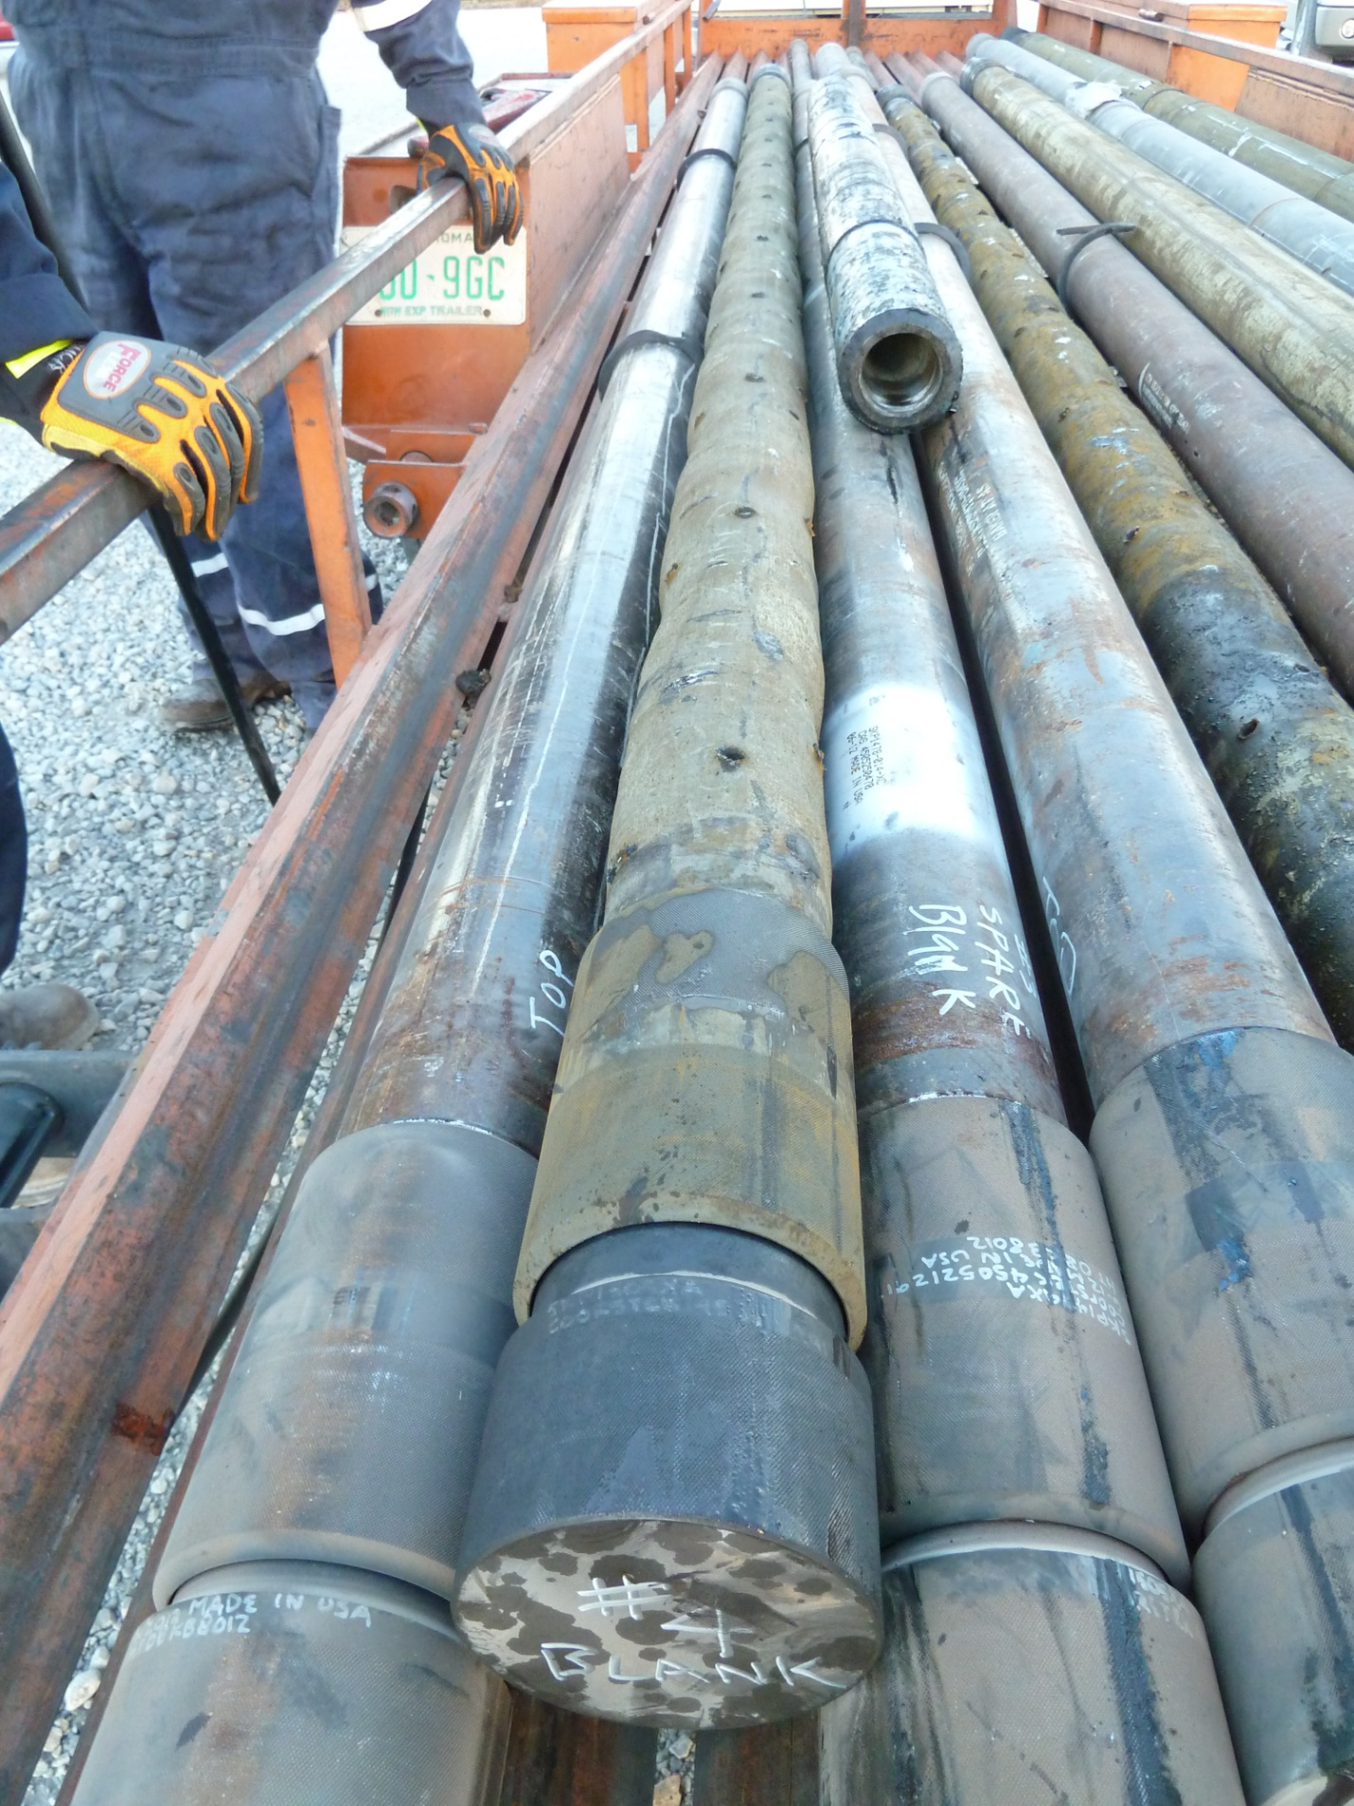
Controlled Field Test
IPS – 15- 21
Results
Loading (and downloading of back-ups) at district location
Successful transport, handling, and make-up of system
Proper pressure initiation of valve/firing head assembly
Ballistic transfer across 5/5 connections
All shots fired
Blow-out plug released
Notes:
As this was a land workover rig, the capabilities were fairly standard. There was a hydraulic catwalk for handling (in the absence of this, cranes for tailing in the guns would be recommended). While the rig crew was very competent and helpful, it should be noted that the gun system didn’t require special handling equipment on location (same safe practices as are recommended with all gun assemblies).

Slide 26
Path Forward
IPS – 15- 21
Actions
Procedure updates from field installation
Field trial installations to fully verify dynamic characteristics seen in section IV lab testing
Further field trial installations (and potential adjustments)
Assess and add future sizes and enhanced features
Notes:
Initial results were positive. There were a few minor modifications for field assembly learned, and we expected some adjustments to come out of this test. The system has proven to be viable for field installations, although we will continue to take a practical approach: seeking to insure compatibility with practical challenges, insuring both basic perforating system issues are addressed as well as those specific to the flow through system issues, and taking a measured approach to applying the technology to increasingly challenging conditions from testing through full field release.

Slide 27
FTPS: Initial Candidate Selection
IPS – 15- 21
Well conditions
  Up to 325F (time dependent)
  8,000 psi max hydrostatic
  7” or larger casing
  Minimum tubing size 3-1/2” for secondary firing system
Typical applications
  Long perforated interval (excessive rat hole cost)
  Proximity to:
    Water contact
    Transition zone
    Drilling challenges (fFractured granite contact, tar zones, etc)
  Wellbore orientation (greater than 60°deviation)
  Requirement for production logging following perforating
Notes:
Temperature: final stability testing in process for upgraded charge tube material; 220F was performed for a specific opportunity; if higher temp required prior to completion of 325 testing, specific tests can be performed.

Slide 28
FTPS Summary
IPS – 15- 21
Allows installation of entire completion prior to perforating interval(s)
Eliminates cost and time associated with drilling rathole
Eliminates production impairment from fluid loss and LCM damage
Eliminates cost and risk of live well deployment (and reverse deployment)
Radically changes completion procedures (and cost) on many long intervals in subsea environments

Slide 29
Acknowledgement
IPS – 15- 21
Baker Hughes would like acknowledge Shell Technology and Mark Brinsden for their contributions during the development of the Flow Through Perforating System.
We offer our sincere thanks for their support.

Slide 30
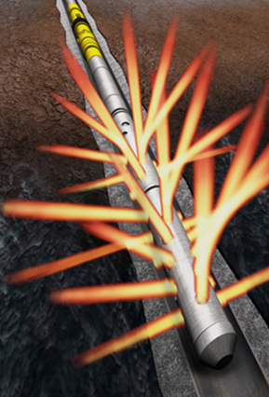
Questions and Discussion
IPS – 15- 21
Thank you.

