Slide 1
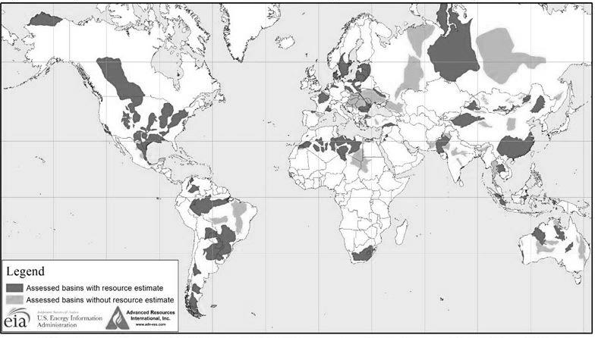
INTERNATIONAL PERFORATING SYMPOSIUM EUROPE
2015
IPS-15-18
Agitating Explosives in Extended Reach Wells –
A Good Idea?
WELL FLOW MANAGEMENTTM
Jack Kolle
General Manager
Kerry Daly
Global BD Manager- DST TCP

Slide 2
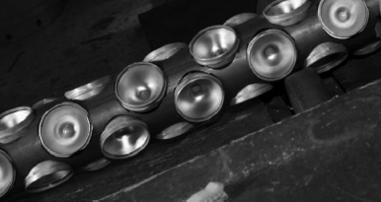
Introduction
IPS-15-18
The total length of horizontal wells increasingly exceeds the normal running limits of coiled tubing (CT), therefore, the industry has invented and adopted the use of water hammers as one option to emplace the coiled tubing and its related equipment into the farthest reaches of the lateral (toe).
Related equipment can include hydraulic jets, mills and motors for cleaning debris out of the well, and tubing conveyed perforating (TCP) guns and firing heads for establishing the flow path into the well for fracturing and production.
From a safety perspective, the use of perforating guns, which contain several types of discreet explosive components designed to fire based on shock or impact (some more sensitive than others), may conflict with the use of water hammers, which axially impact the lowest components of the bottom hole assembly.

Slide 3
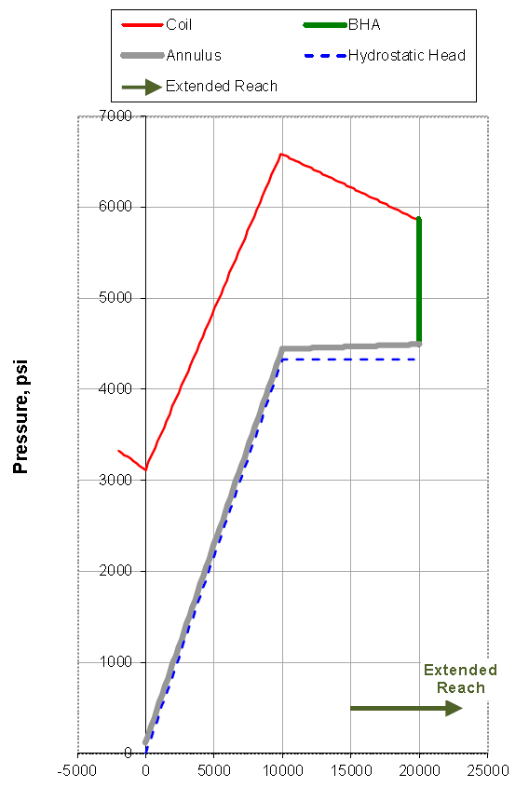
Introduction
IPS-15-18
Sometimes the industry requires this combination in extended reach wells, especially before formation breakdown
where no flow path exists for pumping down wireline guns, or
when primary completion equipment (sliding sleeves) fails.
Modeling tools may allow users to configure tool strings with coiled tubing, water hammers, and perforating guns. However, this does not take into account the compatibility aspects regarding whether this is safe to do so. To truly determine the compatibility beyond simple conjecture, testing is required and has been completed.
This presentation will discuss common techniques and findings established in joint laboratory testing of an industry-leading water hammer run above a typical coiled tubing TCP assembly (toe prep).
Field trial results using live explosives will be discussed.
Also to be presented was an outcome of the testing- the invention of a novel approach (part of which is patented) in which TCP equipment was reconfigured with coiled tubing, water hammer, hydraulic jets or mills and motors - moving it above the water hammer and clean-out tools. This improves operator efficiency by eliminating one or more CT runs, thus saving time and reducing risk.
Modeling Graphic Based on Input Parameters and Results

Slide 4
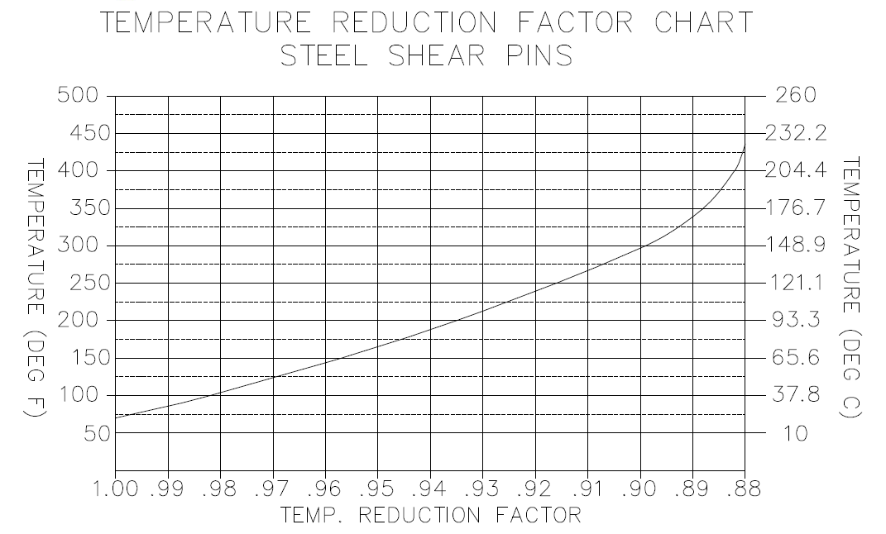
Operational Considerations
IPS-15-18
TCP Pressure Actuated Firing Head
Actuation pressure determined by adding
Hydrostatic pressure at depth of FH
+ Applied pressure for desired effect-
Underbalance/ Overbalance
Based on formation pressure
Minimum typically 1,500 psi above highest anticipated bottom hole pressure
+ Safety factor- typically 1,000 psi
Actuation achieved by shearing multiple steel pins
Typically ~1000 psi @ 70° F each (lot dependent)
Tolerance ± 5%; Affected by temperature
Add multiple pins to get required shear value
Actuation process:
Apply surface pressure against piston held by pins
When pressure is exceeded, pins fail allowing firing pin to impact explosive initiator
Guns fire
Pins
Pressure Activated Firing Head

Slide 5
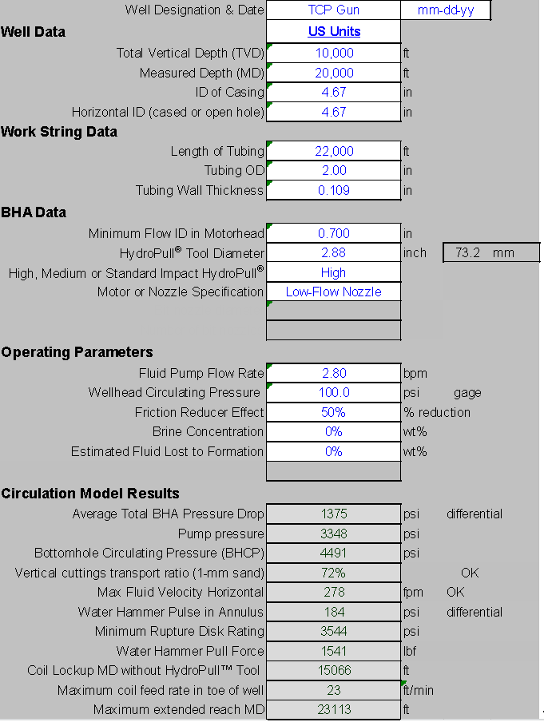
Operational Considerations
IPS-15-18
Purpose:
Extends coiled tubing (CT) operational limits
friction leads to loss of weight and helical buckling.
Water hammer pulls on the end of the CT and creates axial vibrations> delivers ~1000 psi force at bottom
delivers accelerations equal to 40 g
Allows CT to overcome friction and keep moving
What effect on TCP guns
charge liners, shear pins, etc.?
Operates based on flow through coiled tubing (~3 bmp)
generates increased pressure in the wellbore due to friction (2” Coil in 5-1/2” casing creates 100 psi)
generates cyclic pressure variations due to water hammer effect (2” Coil in 5-1/2” casing creates 184 psi)
not accounted for in TCP firing head calculation
What effect on TCP guns?
Water Hammer
WH
WH
Modeling Input
Parameters and Results

Slide 6
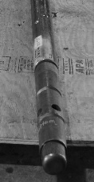
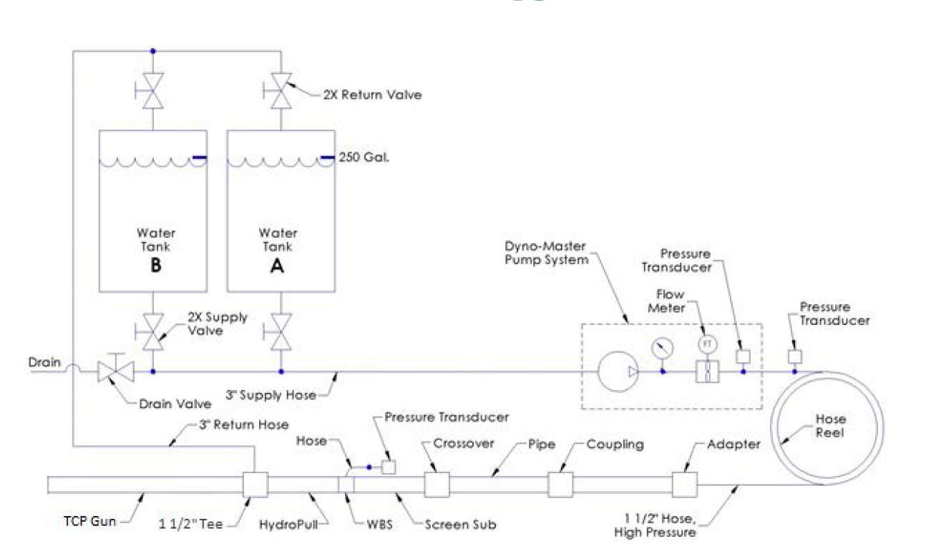
Test #1- Flow Loop
IPS-15-18
TCP System below Water Hammer:
Scope:
Pressure pulses in closed system well understood and accounted for in model- testing not required
Accelerations and fatigue effect from long term cycling- not known on TCP firing head or charges
Configuration (from bottom up):
Accelerometer mounted on firing head
Pressure-activated firing head
with 1 pin (nom. 1075 psi).
Quantity (4) 3-1/8” OD guns
with CT Time Delay Transfer
subs in between
no live explosives
dummy charges included
(same load, borax powder)
2-7/8” Water Hammer
2-7/8” Water Hammer Screen
2-1/2” pipe
TCP firing head and gun assembly
Water
Hammer
Flow Loop with TCP Toe Prep System

Slide 7
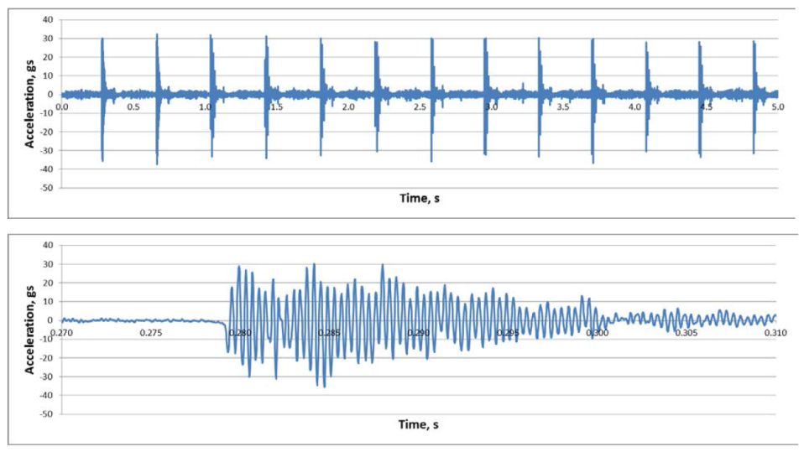
Test #1- Flow Loop
IPS-15-18
TCP System below Water Hammer:
Results (after 10.75 hours= 100,000 cycles)
Pressure above Water Hammer @ 2.6 bpm
~2200 psi
Calculations:
Force= Mass x Acceleration
where peak accelerations= 40 g (±392 /m/s²)
and 1” OD piston has mass=0.42 kg,
So axial acceleration force= 46 psi,
a small fraction of the fatigue limit of 1 pin
Accelerations at PAFH: +30g/ -32g

Slide 8
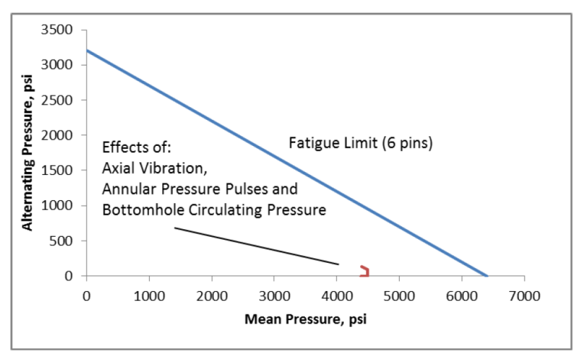
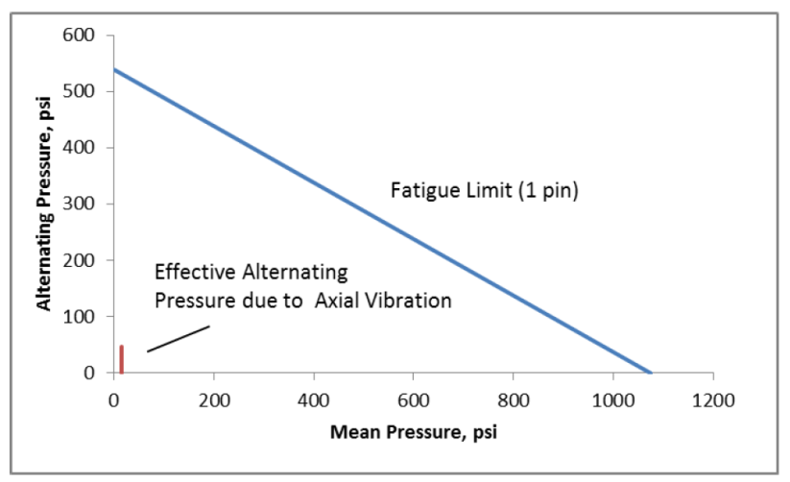
Test #1- Flow Loop
IPS-15-18
TCP System below Water Hammer:
Results (after 10.75 hours= 100,000 pulse cycles)
Goodman fatigue limit diagram for a PAFH w/
6 pins and BHCP with 2” CT in 5.5” casing
Visual Inspection:
No damage was visible
No loosening of liners
No loosening of charges in strip
No loosening of cord from charges
Testing of pin afterwards fell w/in specification
Before
After

Slide 9
Test #2- Field Trial
IPS-15-18
TCP System below Water Hammer:
Job Record:
Pickup TCP
NU and RIH with Water Hammer/ Gun BHA
RIH and Rolling Pumps- ½ bpm
@6600-ft, up to 1.5 bpm @ 800-1100 psi circ pressure
@8900-ft, up to 2.5 bpm @1500-1800 psi circ pressure
@10,200-ft, up to 3.5 bpm @2300-2650 psi circ pressure
Slowed rate to 3.25 bpm @2100-2400 psi circ pressure
@14,989, can’t go any further. Take up slack, prepare to shoot.
Shut in well and pressure up.
Toe gun fired at 3120 psi> good indication
Delay 1 fired s at 5.54 min> good indication
Delay 2 fired at ?> no indication. Moved @ 6.5 min
Delay 3 fired at ???> no indication. Moved at 6.5 min
Delay 4 fired at 5.03 min> good indication
Waited 10 min, POOH
OOH with BHA> all shots fired
Well bore:
VD of 6600-ft
MD of 15000-ft.
Initially tried to TCP w/ a 2” coil unit and could not get all the way down.
Spent almost 2 days fighting friction.
Client decided to get a 2-3/8” unit and run Water Hammer to try again.
Firing Head Calculations:
Loaded with 6 pins
Nom. Actuating Pressure= 6036 psi
Surface Applied Pressure= 3148 psi
PAFH
BHA: Water Hammer
Circ Sub
BHA: Toe Gun Assembly

Slide 10
Analysis/ Results
IPS-15-18
Analysis of Current System:
Requires two separate runs for clean-out and TCP
Water Hammer with circulation ports must be run above TCP assembly
This leaves 30-40 feet of guns being bullheaded in with no flow support (not effective for cleaning).
Better option would be to move the Water Hammer/ Circulating Port/ Clean-out tools below
One-Trip System (US Patent #7650947):
One-trip design eliminates 1 coiled tubing run- combines Water Hammer/ Clean-Out/ TCP
Full flow tubing (1.50 ID) parallel to guns optimizes performance of Water Hammer/ Clean- out Tools
Annular pressure activated firing head- rupture disk + pins for dual safety
Low-side BH gun to optimize EHD for establishing flow
Proposed:
BHA: Toe Gun Assembly with PAFH
Water Hammer
Circ Sub
CT Connector/ Motor Head Assembly
(above)
Water Hammer / Cleanout Tools
(below)

Slide 11
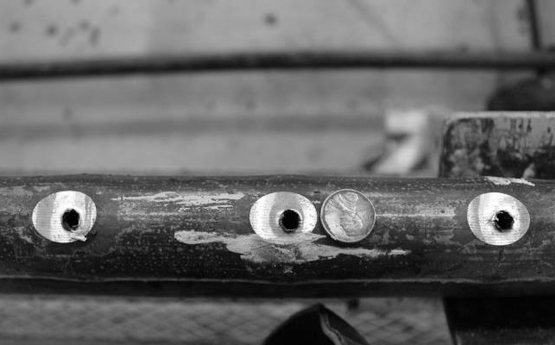
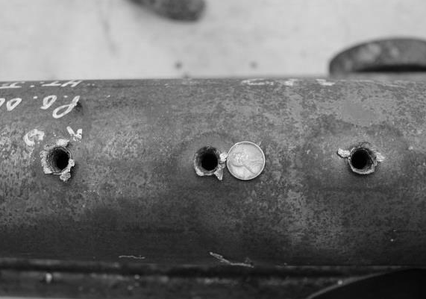
One-Trip Test #1- Gun Test
IPS-15-18
TCP System above Water Hammer:
Scope:
Ensure that the gun system produced adequate perforation flow area to break down formation
Ensure that the parallel flow tube was not damaged from perforating operation
A) Visual inspection after perforation test
Configuration:
Fully loaded gun- 4-ft x 1-9/16 4 SPF @ 0° Phase
Quantity (12) 3 gram HMX BH charges
Loaded assembly was placed in 4-1/2” HW Casing (12.1 ppf)
Gun and casing were placed horizontally in a remote water pit
Electrically detonated due to surface test limitation
View of One-Trip System
Gun Avg EHD= 0.21 in.
Casing Avg EHD= 0.35 in.

Slide 12
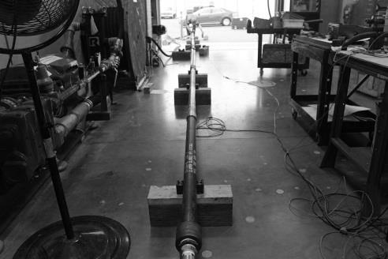
One-Trip Test #2- Flow Loop
IPS-15-18
TCP System above Water Hammer:
Scope:
Accelerations and fatigue effect from long term cycling- not known on TCP firing head or charges
Ensure that the parallel flow tube was not damaged from perforating operation
B) Flow test through tubing to confirm no damage occurred.
Configuration (from bottom up):
Mill & Motor (simulated- reservoir with mass followed by orifice)
2-3/8” Water Hammer
Transducer Sub
Screen assembly (keeps solids/ debris out of Water Hammer).
One-Trip assembly- PAFH had 1 pin
Transducer
Lubricator (replaced with Coiled Tubing Motor Head assembly in live well BHA)
Pump rate ~ 3 bpm (maximum for system)
View of Flow Test
(from bottom up)

Slide 13
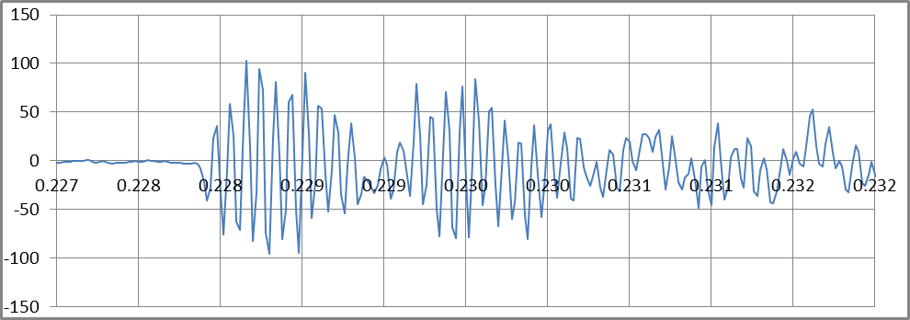
One-Trip Test #2- Flow Loop
IPS-15-18
TCP System above Water Hammer:
Results (after 100,000 cycles)
Pressure at pump measures 640 psi average, however Water Hammer pressure pulses far exceed that (high amplitude but short duration).
Note: Pressure pulses should not cause premature actuation of rupture disk since pulses are internal to tool and rupture disk is annular.
Measured Accelerations “+” = downhole, “-“ = up hole
above Water Hammer: +670g/-610g over all max, +540g/-490g approx. average
above One-Trip: +133g/-127g over all max, +/-100g approx. average
@ Firing Head: +465g/-405g over all max., +370g/-320 approx. average
~10x higher than previously measured with Water Hammer above TCP assembly
Accelerations above One-Trip
Accelerations at Firing Pin

Slide 14
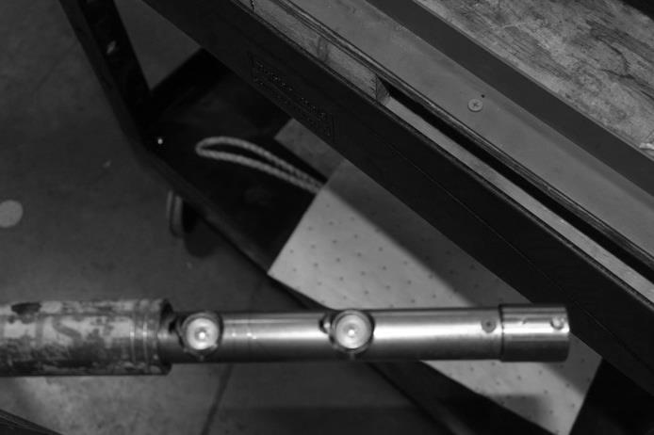
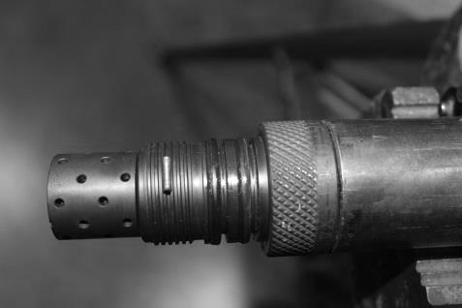
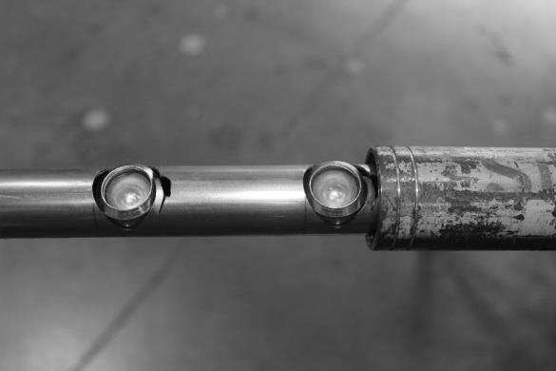
One-Trip System Test #2- Flow Loop
IPS-15-18
TCP System above Water Hammer:
Results (after 100,000 cycles)
Visual Inspection:
No damage was visible
No loosening of liners
No loosening of charges in strip
No loosening of cord from charges
Before: Charges in strip
After: Firing & Shear Pins- No Damage
After: Charge liners and Position-
No Damage
Testing of pin afterwards fell w/in specification

Slide 15
Analysis/ Results
IPS-15-18
TCP System above Water Hammer:
Conclusion:
Accelerations were 10x higher when the water hammer was run below the one-trip TCP system.
Calculated stress of the PAFH shear pin would be equivalent to 460 psi (based on 46 psi x 10).
A six-pin PAFH should easily withstand this, however the safety factors are smaller.
Analysis:
The higher level of acceleration is related to the higher flow rate and pressure spikes in the small flow tube of the one-trip TCP system.
Recommend modifying the configuration:
Position the water hammer above the TCP array to reduce the acceleration levels, bending moments and pressure variation in the flow tube and connections.
Position the PAFH at the lower end of the TCP array- possible with no detrimental affects.
Next Step:
Field Trial
Modified Configuration
Water Hammer
(above)
Cleanout Tools
(below)
Gun
FH

Slide 16
Summary
IPS-15-18
Water Hammers have proven themselves a viable option for extending the reach of Coiled Tubing
The related acceleration and pressure pulses from the downhole operation of water hammers could detrimentally affect TCP explosive components, so Expro and Tempress tested
Flow Loop testing has proven that the use of Tempress’ water hammer, when run above a typical TCP Toe Prep assembly with Expro firing head, can be done safely
A field trial has validated the Flow Loop testing and proven that the use of this water Hammer, when run above an Expro TCP Toe Prep assembly, can be done safely
The limitation of design is that two separate runs are required for Clean-out and TCP Toe Prep.
As a result, a patented One-Trip design has been evaluated which allows combining TCP equipment, Water Hammers and Clean-out tools.
Gun system testing has proven a) adequate flow area and b) that flow tube was not damaged.
Flow Loop testing has proven that the use of Tempress’ water hammers and clean-out tools, when run below the Expro One-Trip TCP assembly, can be done safely.
Benefits:
Clean-out tools are moved to the bottom of assembly, optimizing bottom’s up clean-out
Full flow parallel to TCP allows high bpm’s for Water Hammer/ Clean-out tool function
TCP/ Water Hammer/ Clean-out tools all operational in One-Trip, saving one CT run
A field trial of the One-Trip system is pending.

Slide 17
Summary
IPS-15-18
To answer the question:
Agitating Explosives in Extended Reach Wells - A Good Idea?
An acceptable idea, but only with system proven safe by testing!
Other manufacturers’ systems should be validated prior to use!

Slide 18
Questions? Thank you!
INTERNATIONAL PERFORATING SYMPOSIUM EUROPE
2015
IPS-15-18
Agitating Explosives in Extended Reach Wells –
A Good Idea?
WELL FLOW MANAGEMENTTM
Jack Kolle
General Manager
Kerry Daly
Global BD Manager- DST TCP

