Slide 1
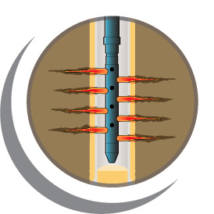
Modern Slickline Perforating Applications in the North Sea
Andy Martin
IPS-15-15

Slide 2
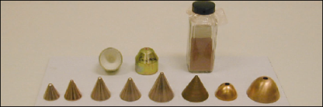
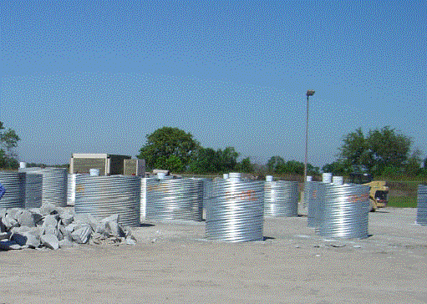
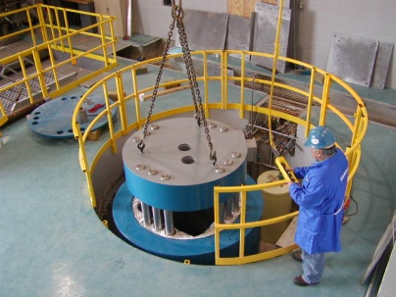
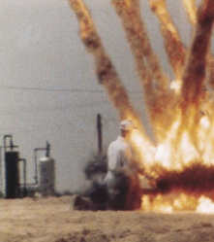



Agenda
Introduction
Slickline Controlled System
Real-Time
* Mark of Schlumberger

Slide 3
Introduction

Slide 4
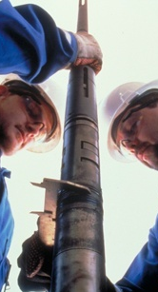
Slickline Benefits and Limitations
  Benefits of Slickline intervention
    Small footprint, mechanical integrity, logistical simplicity, operational efficiency, cost efficiency
  But with inherent limitations
    Limited visibility and clarity of downhole toolstring
    actions and status
    Limited depth precision
    Limited downhole functionality
    Over-dependence on slickline operator’s experience level

Slide 5
Historical Slickline Perforating
Time
Pressure
Detonation
Temperature
No real time correlation
Parameter run
Limited application

Slide 6
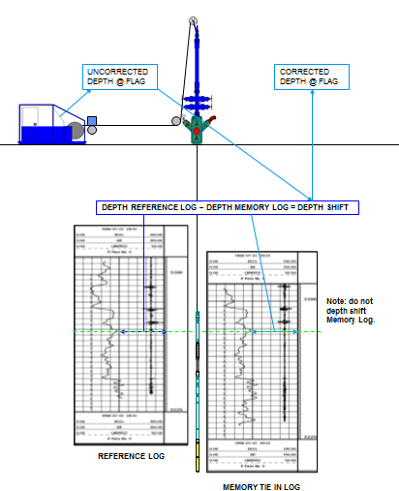
SL Depth Control
Memory GR-CCL log
  Tool string same weight and OD as perforating string
  Mark line
Match to reference log
  Calculate offset
Perforating run
  Run to depth mark
  Correct to offset
  Position on depth
Reference: SPE 81536

Slide 7
Slickline Controlled Systems

Slide 8
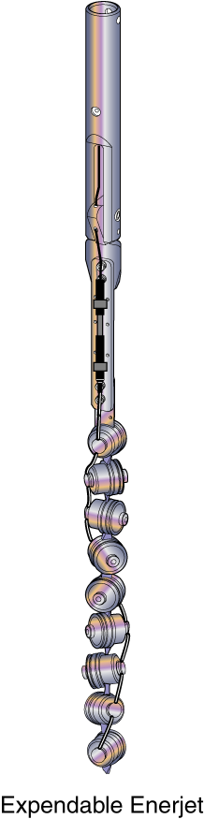
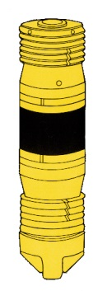
Slickline Controlled Firing Head
Introduced ~1999
No parameters run
No primary explosives & RF safe
Direct control at all times
Independent control of two tools
>1000 runs to date in North Sea alone

Slide 9
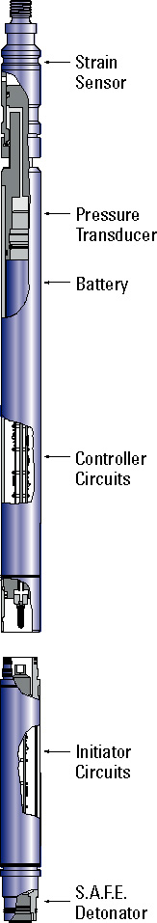
Pulsed Controlled Firing Head
Strain
Sensor
Pressure
Transducer
Battery
Pulse generated by pulling up 2 to 3 ft or more depending on depth
SPE 72325
Controller
Circuits
Initiator
Circuits
To Pressure
Sensor
Get on depth
Fire
EFI
Detonator
1min
1min
1min
1.5 min
1.5 min
5 min
2 min

Slide 10
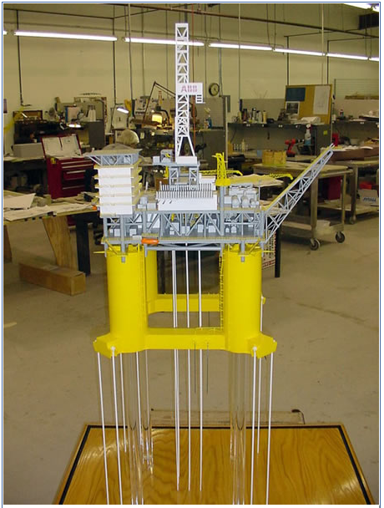
Early North Sea Applications
Inde platform: Punch above stuck plug (SPE 72325)
Ravenspurn: Packer set near surface (no pressure contrast SPE 72325)
Cut tubing on abandonment of 40 wells on Hutton TLP
  80 days saved
Hutton TLP

Slide 11
Recent Example—Offline HT Well
>100 ft of perforating at ~350degF, ~5000 psi on gas well
Operator choose slickline as more cost effective
  Easier rig up
  Pressure control easier on gas well
  Running speeds higher than wireline
  2 7/8” guns with rock-optimized HNS charges
2 correlations runs and 8 successful perforating runs

Slide 12
Real-Time

Slide 13
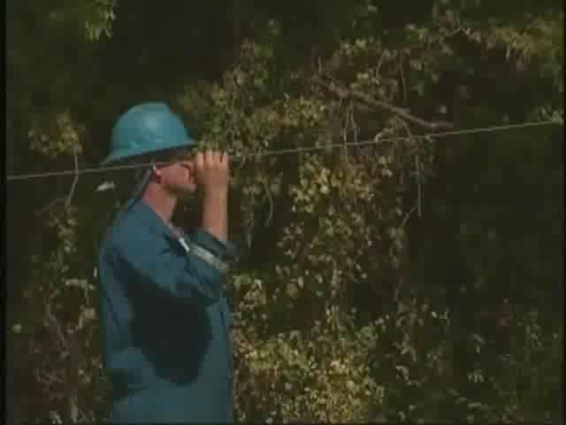
Real-Time Shot Detection

Slide 14

Real-Time Slickline
  Precision, certainty and control across all slickline operations
    Correlation Precision
      Accurate real-time depth correlation and
      validation of toolstring position relative to
      completion or reservoir
    Confirmation of status
      Surface read out of tool actions and status,
      reducing uncertainty and eliminating unnecessary trips
    Continuous control
      Dynamic toolstring control via robust digital communication, allowing real-time program changes

Slide 15
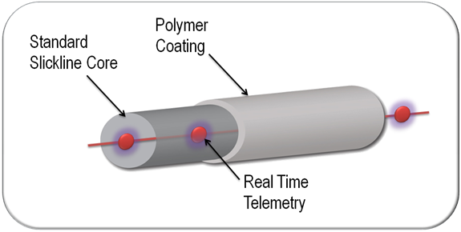
Real-Time Slickline
  Digital data telemetry
    Real-time, two way communication with tool-string
Telemetry NOT power
  Surface readout of critical data
    Shock, deviation, head tension
    Gamma Ray and CCL
    Borehole pressure and temperature
    Surface controlled jarring, tool release and perforating
  Specifically-built tool modules to perforate, perform production logs, set plugs/packers

Slide 16
Real-Time Data
Core App Tools
Optional App Tools
Tool Description
Basic Measurement Cartridge
Digital Correlation Cartridge
Digital Pressure Gauge
Digital Controlled Release
D-Trig
Trigger Module
Explosive Device
i.e. Gun
Cutter
Plug Setting Tool

Slide 17
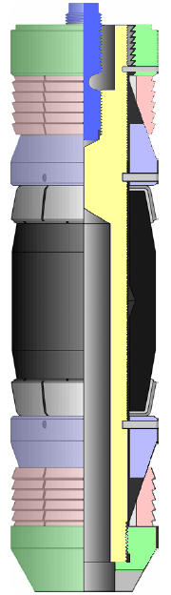
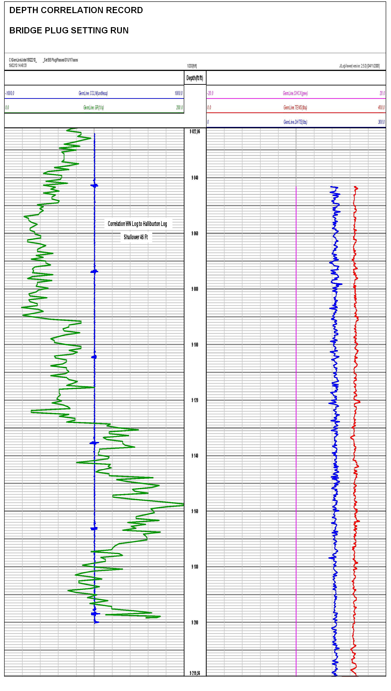
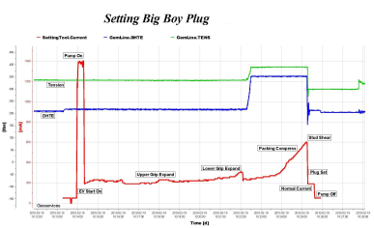
Real-Time Example
  Explosive-Free Setting
    Electro-hydraulic setting tool
    Real-time depth control
    Plug setting QC in real-time

Slide 18
Well Abandonment

Slide 19
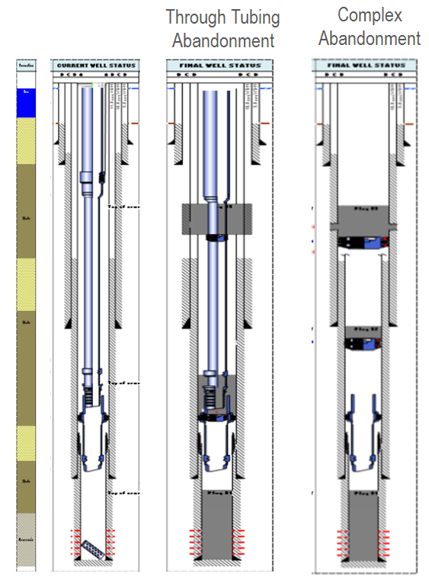
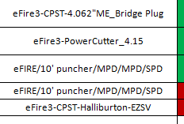
Typical North Sea Abandonment
Barrier planning
  Well integrity logs
Barrier installation
  Cutters, plugs, cement retainers, punchers
Barrier verification

Slide 20
Slickline Work
Set bridge plug
Cut tubing
Punch casing
Set cement retainer
All performed with slickline electronic firing head or real-time systems

Slide 21
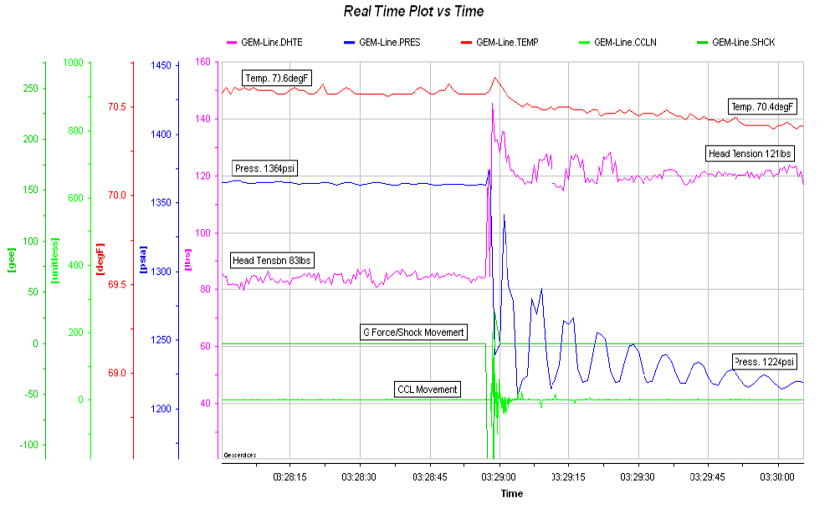
Tubing Punched
Head Tension
Pressure
Temp
CCL
Shock
Temperature drops
Tension up 40 lbs
Pressure drops 140 psi
Detonation shock

Slide 22
Industry Publications
OTC 23916 Impact of DSL for P&A Operations
SPE 154439 Risk Reduction and Efficiency Gains Through Application of DSL
SPE 168292 Beyond Logging: Slickline Operations Can Now Provide More Efficient and Cost Effective Alternative to Traditional Intervention Operations.
SPE 168270 Perforating and Pipe Recovery with Digital Slickline First Application in Colombia Field
SPE 168252 Real Time Slickline: Unlocking Additional Production With Reduced Uncertainties in Limited Space Platforms

Slide 23
Perforating
Introduction
Slickline Controlled System
Real-Time
Questions?

