Slide 1
SPE144167
Evaluation and Design of Shaped Charge Perforators, and Translation to Field Applications
J. Hardesty, M.R.G. Bell, and N.G. Clark, GEODynamics, Inc.
T. Zaleski and S. Bhakta, INGRAIN, Inc.

Slide 2
Outline
Introduction
  Perforation Performance Evaluation
  Perforation Geometry and Implications
Laboratory Evaluation
  Berea Sandstone
  Castlegate Sandstone
  Mancos Shale
Field Application
Conclusions

Slide 3
Perforation Performance Evaluation
Historical Objectives:
  Inexpensive and Repeatable Testing
  Simple Translation to Field Performance
  Predictive Software Models
  Simple Tunnel Geometry for Analysis
Results:
  Oversimplification of Geometry
  Extrapolation of Penetration Translation

Slide 4
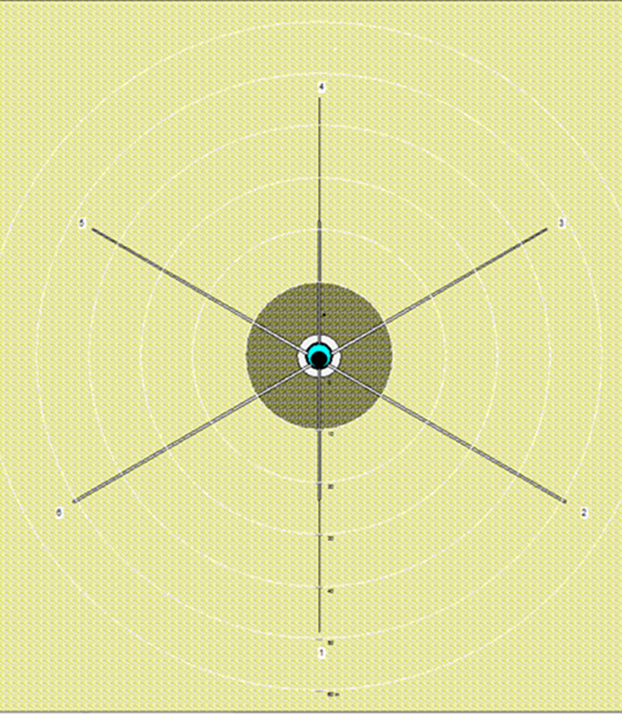
Perforation Performance Evaluation
22.7 g Charge
API Cement 39.02”
8” Borehole
10” Damage Radius
Perforations Far Field
Commodity Selection
Assumed Open
Doesn’t Match Reality

Slide 5
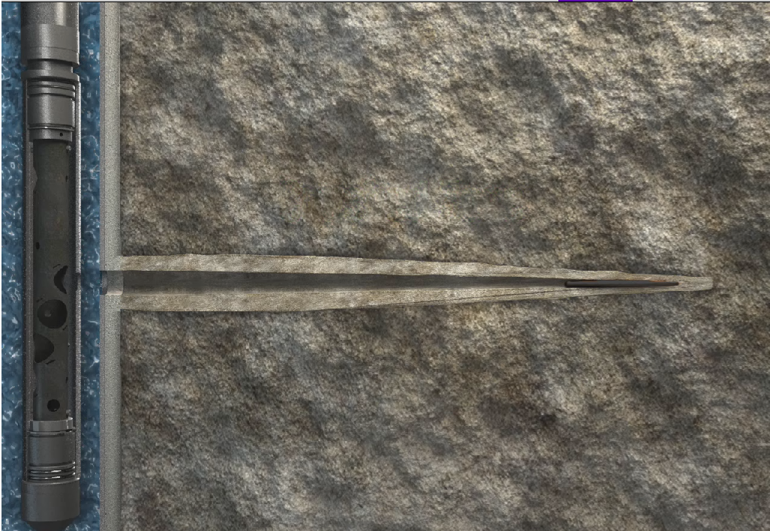
Perforation Performance Evaluation

Slide 6
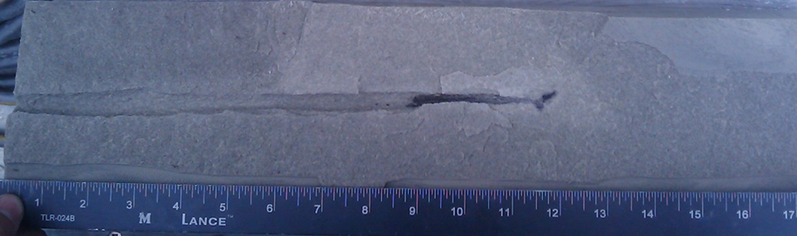
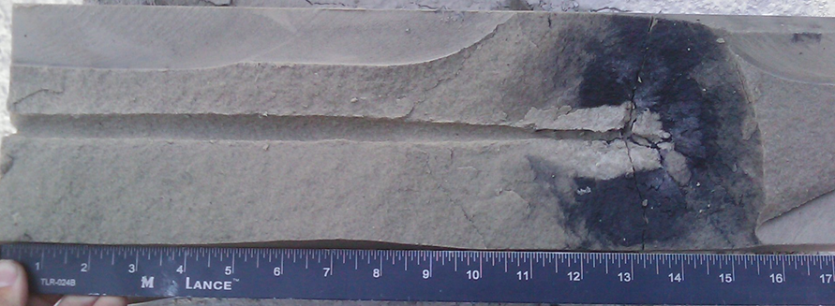
Perforation Geometry

Slide 7
Reactive Perforating
Designed for improved tunnel geometry
Intermetallic reaction between charge liner materials, triggered by detonation pressure
Exothermic reaction
  Heats tunnel volume & near-tunnel pore space
  Consumes supporting liner material
Breaks up and expels debris from tunnel
Effect occurs in each tunnel, independently
Clean tunnels with less reliance on surge

Slide 8
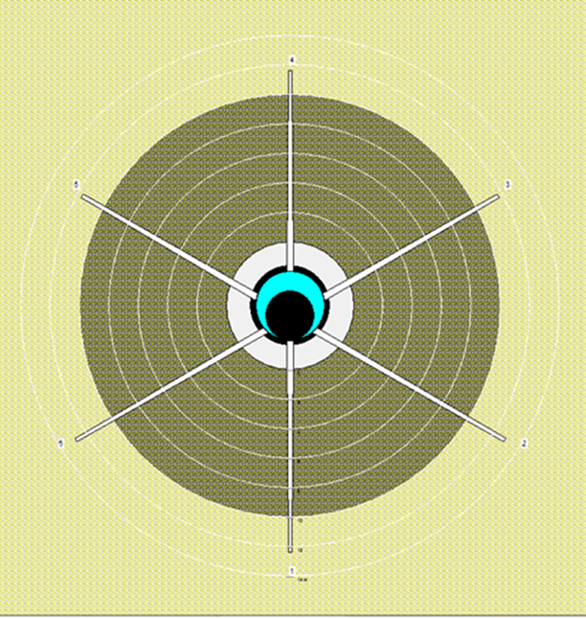
Perforation Performance Evaluation
22.7 g Charge
Cement Pen
8” Borehole
10” Damage Radius
Perforations Near WB
Performance Valuable
Geometry Important
Testing Useful

Slide 9
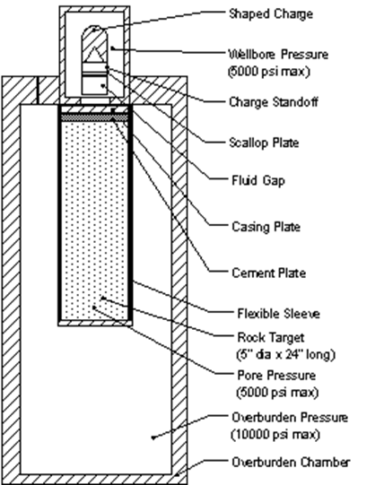
Laboratory Evaluation: Procedure
5” x 18” Targets
OMS Working Fluid
Axial Flow Permeability
1000 psi Back Pressure
Overburden: 8000 psi
Pore: 4000 psi
Wellbore: varies
Axial Flow Evaluation
Slight Dynamic OB

Slide 10
Laboratory Evaluation: Procedure
Axial Flow Evaluation
Minimal Dynamic OB
Production Ratio Flow Evaluation
Perforations Measured and Targets Split
Tunnels Unaltered

Slide 11
Laboratory Evaluation: Berea Sandstone
15g HMX Conventional Baseline:
API RP 19B 35.1”
Berea Sandstone
  100-150 mD
  19% porosity
  7000 psi UCS
Typical Penetration:
  8-9 inches
  Insensitive to initial balance

Slide 12
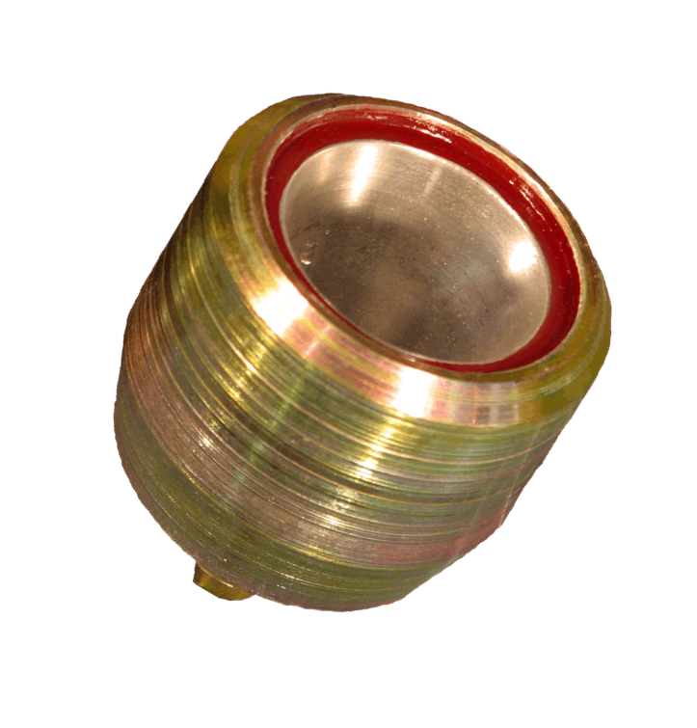
Laboratory Evaluation: Berea Sandstone
15g HMX Reactive
Reactive Component:
  Applies Radial Mechanical and Thermal Energy
  Prevents formation of wedged target pack
  Causes Clean up and Fractures
Design Criteria:
  Equal or Better Penetration in 7K-10K UCS Sandstone
  Improved Geometry
  Improved Flow
Liner material
modified to incorporate reactive materials

Slide 13
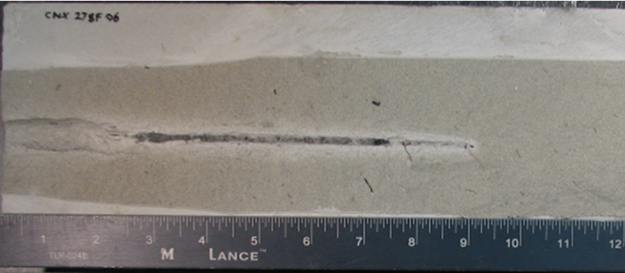
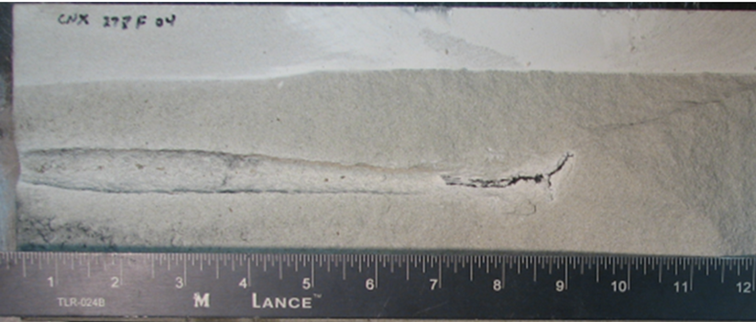
Berea Sandstone at Maximum Overbalance

Slide 14
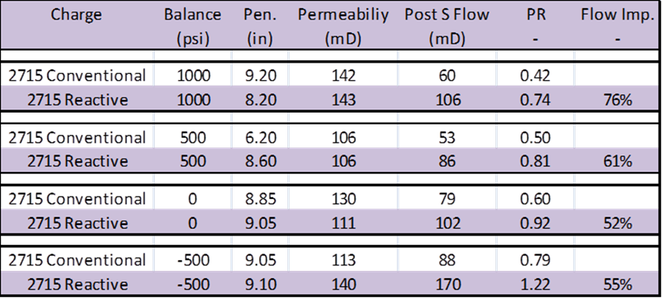
Berea Sandstone Flow Performance

Slide 15
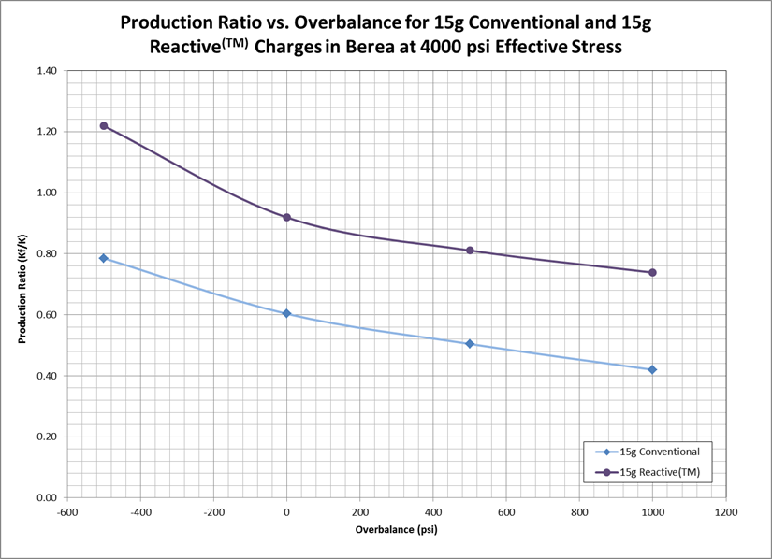
Berea Sandstone Flow Performance

Slide 16
Laboratory Evaluation: Berea Sandstone
Flow Performance is 55% to 76% superior to the conventional charge at every balance condition.
Reactive Charge at 1000 psi overbalance performed equivalently to the conventional charge at 500 psi underbalance.
With slight underbalance, the reactive perforation tunnel flow performance surpasses 1.0 Production Ratio.

Slide 17
Lab Evaluation: High Perm Sandstone
15g HMX Conventional Baseline:
API RP 19B: 35.1”
Castlegate Sandstone
  700-900 mD
  20-21% porosity
  Less than 5000 psi UCS
Typical Penetration:
  10-13 inches
  Insensitive to initial balance

Slide 18
Lab Evaluation: High Perm Sandstone
15g HMX Reactive HP
Reactive Component:
  Redesign of standard Reactive Charge
  Reactive Component modified for optimal geometry in Castlegate Sandstone
Design Criteria:
  Increase Penetration over standard Reactive
  Improve Geometry and Flow Performance over Conventional

Slide 19
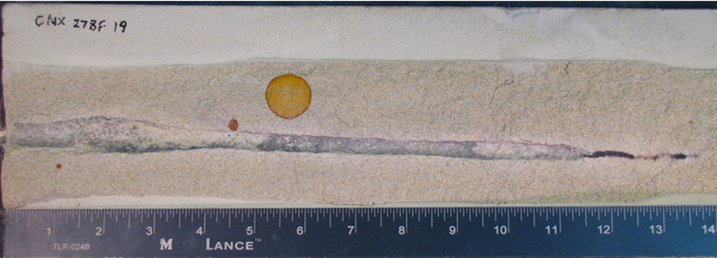
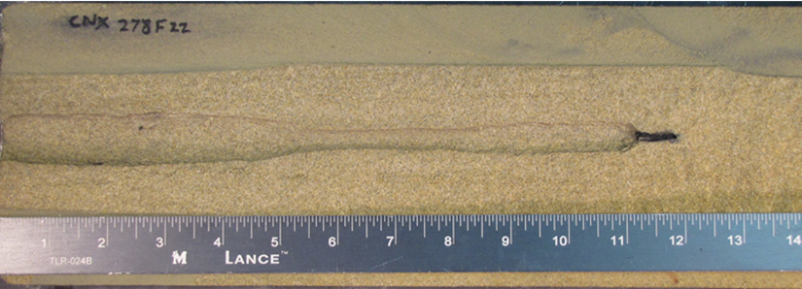
Castlegate SS at Balanced Condition

Slide 20
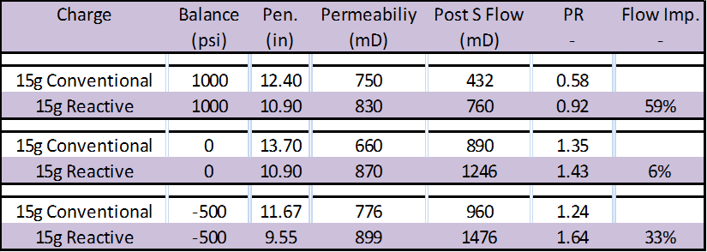
Castlegate Sandstone Performance

Slide 21
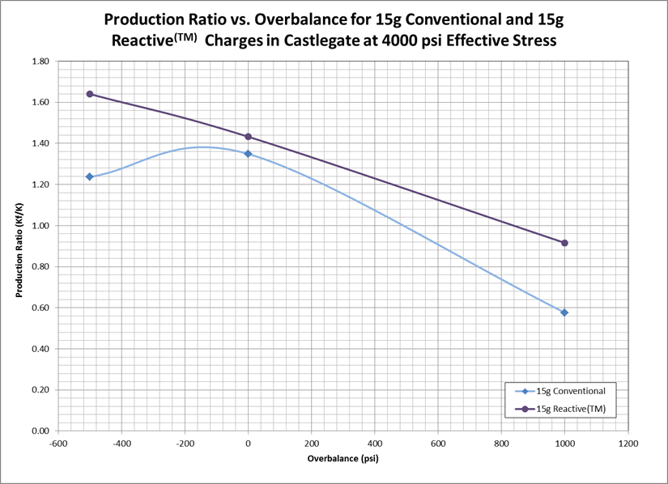
Castlegate Sandstone Flow Performance

Slide 22
Laboratory Evaluation: Castlegate
Flow Performance is 6% to 59% superior to the conventional charge at every balance condition.
Optimized Reactive Charge provided a PR of 0.92 at overbalance condition.
Conventional charge produced deeper tunnels, however reactive design produces cleaner perforations, with better side wall condition.

Slide 23
Lab Evaluation: Mancos Shale
15g HMX Conventional Baseline:
API RP 19B: 35.1”
Mancos Shale
  Low Permeability
  Low Porosity
  Geometry Evaluation
Typical Penetration:
  7-8 inches

Slide 24
Lab Evaluation: Mancos Shale
15g HMX Reactive HP
Reactive Component:
  Standard Design Reactive Charge
  Design Optimized for 10mD to 300 mD Sandstone
Design Criteria:
  Equal or Better Penetration in 7K-10K UCS Sandstone
  Improved Geometry
  Improved Flow

Slide 25
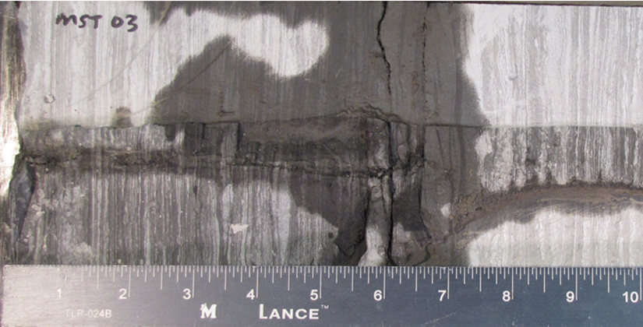
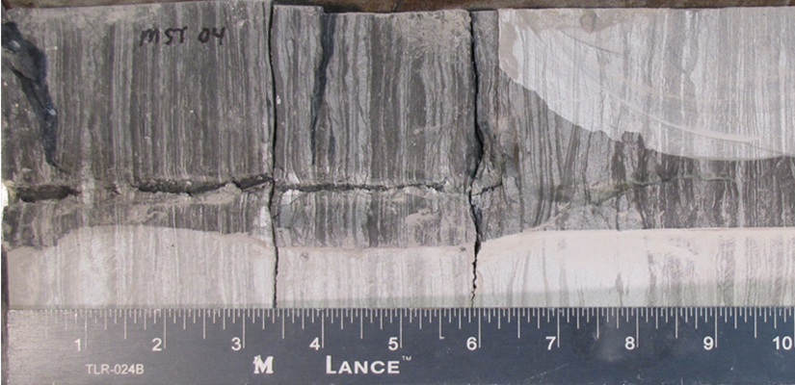
Mancos Shale Perforation Geometry

Slide 26
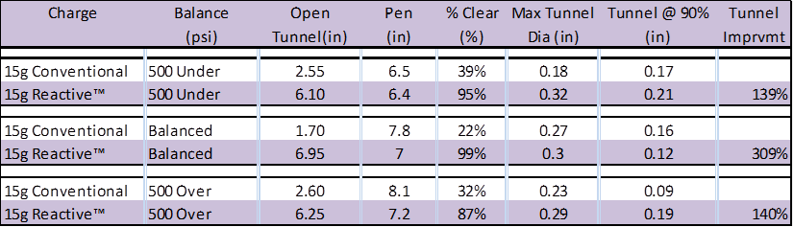
Mancos Shale Performance

Slide 27
Laboratory Evaluation: Mancos Shale
Open Tunnel not sensitive to initial balance condition.
Penetrations similar, with conventional charges having slightly deeper penetration at every condition.
Reactive charges show increased open tunnel lengths ranging from 140% to 300% improvement.
Reactive have larger diameter tunnels.

Slide 28
Design Methodology – Field Results
14 Wells completed by CNX between May 2008 and October 2009
Chattanooga Shale
4-9 Fracture Stimulations
Treatment Sizes
  15,000 to 30,000 gallons
  50,000 to 100,000 lbs. of proppant
Stimulation and Production data for 81 stimulation stages

Slide 29
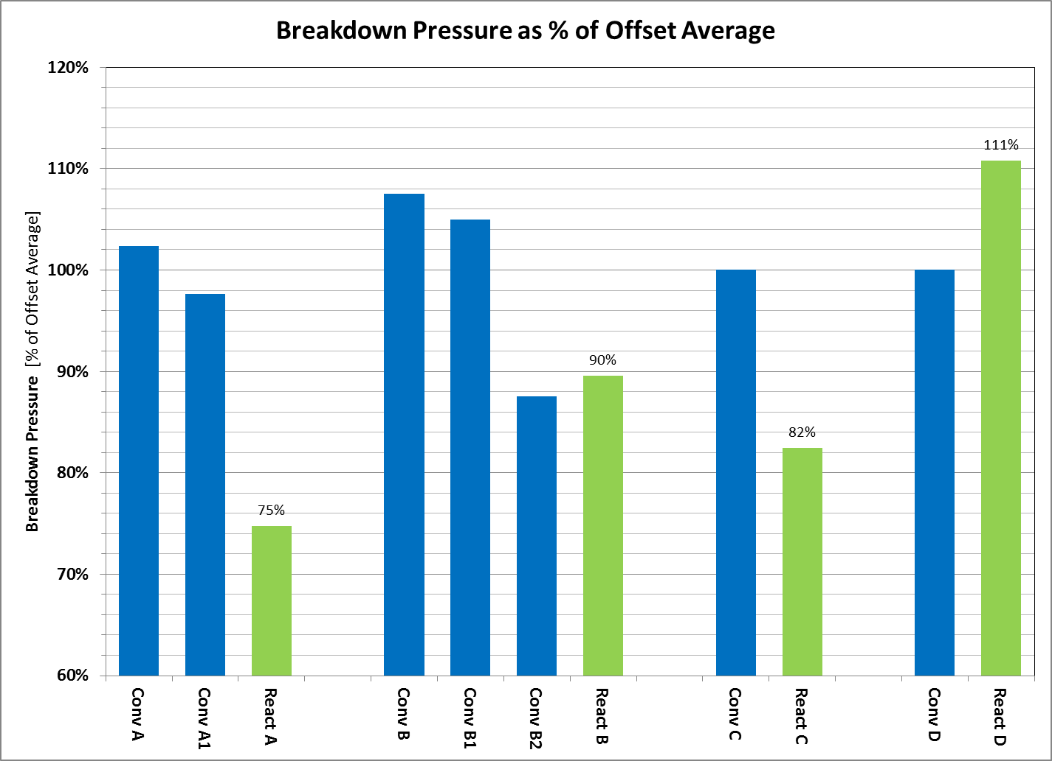
Field Results – Breakdown Pressure Red

Slide 30
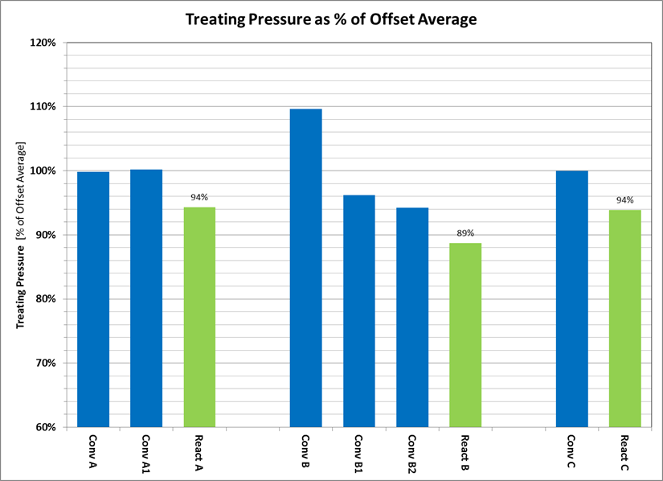
Field Results – Treating Pressure Reduction

Slide 31
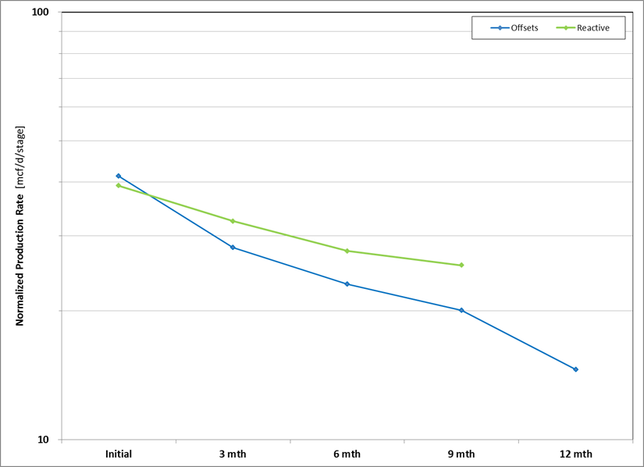
Field Results – Productivity Improvements

Slide 32
Field Results – Offset Comparison
4 Offset Groups
13% to 29% Reduction in Breakdown Pressure
6% to 15% Reduction in Treatment Pressure
Improvement in Early Productivity Decline

Slide 33
Conclusions – Near Wellbore
Perforating system design and technology is important for many completion applications
Overreliance upon cement penetration and penetration models has caused lost production.
The interaction of perforation geometry with near wellbore structures is relevant to well performance for many completions.

Slide 34
Conclusions – Field Results
Shaped charges developed for 10-200 mD sandstone have been proven effective in laboratory and field for shale formations.
Improvements reported confirm previously reported results. (SPE 116226, SPE 122174, SPE 125901)
It is likely that future work could develop a perforating system which is better suited for shale fields.

Slide 35
Conclusions – Shaped Charge Design
Shaped charges can be optimized for performance different formations and applications.
Shaped charge perforator design based upon targeted geometry improvements has been demonstrated to be effective in the lab and in the field for:
  Sandstone, 10-200 mD
  Sandstone, 300-1000 mD
  Shale

Slide 36
Thank you!
The authors would like to thank Sean Brake and CNX Gas Company LLC for the generous sharing of their field experience.
For more: SPE144167
John Hardesty
Principal Research Engineer, GEODynamics, Inc.
john.hardesty@perf.com

Slide 37
Supporting Information

Slide 38
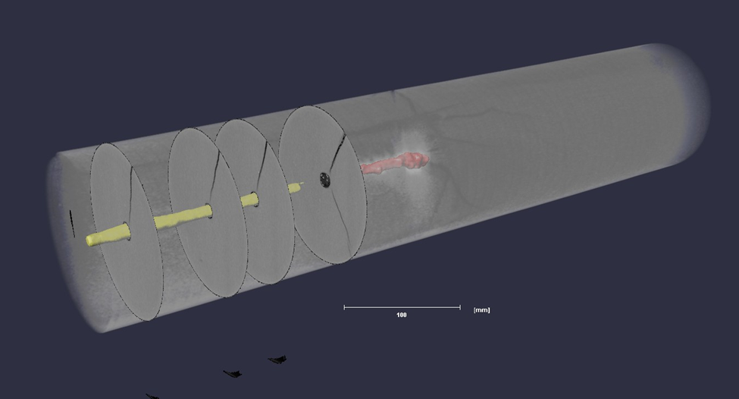
Permeability Map, Conventional Tunnel

Slide 39
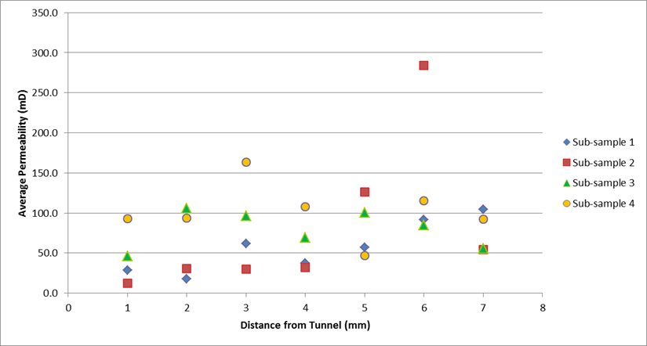
Permeability Map, Conventional Tunnel

Slide 40
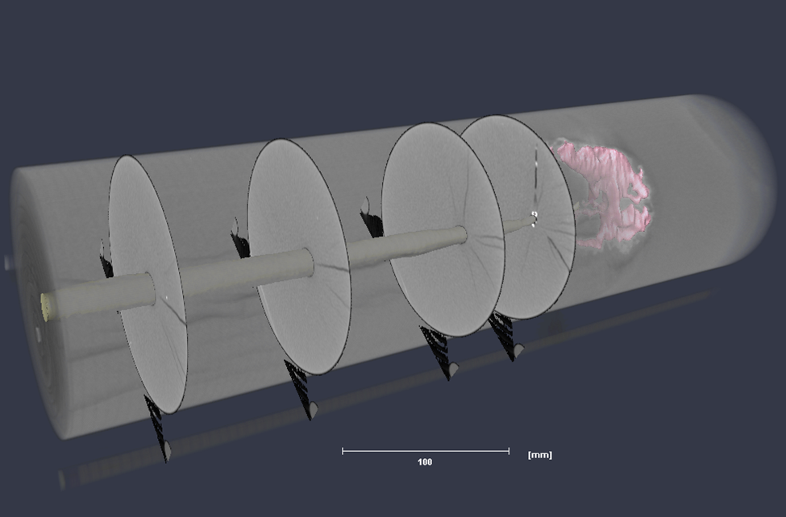
Permeability Map, Reactive Tunnel

Slide 41
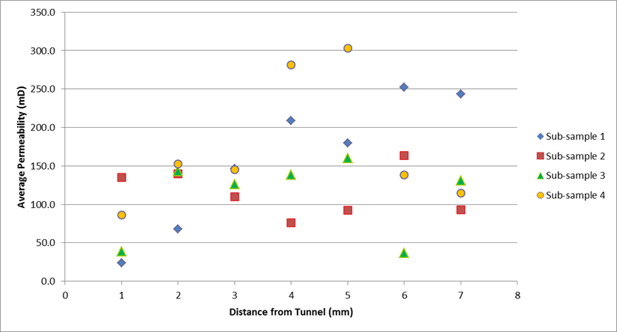
Permeability Map, Reactive Tunnel

Slide 42
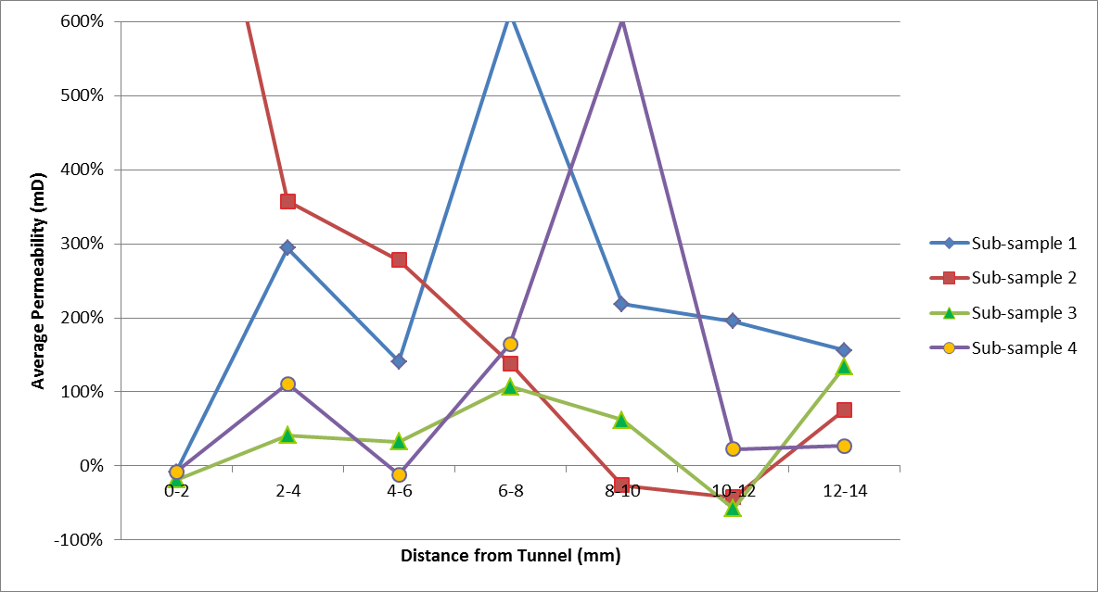

Slide 43
Conclusions – Permeability Distribution
Permeability distribution is complex – uniform thickness damage model may be inadequate.
Permeability distribution is a feature of charge design, in addition to test/field conditions.
This reactive charge design (25g HMX) shows over all improvement in side wall permeability compared to conventional charge.

Slide 44
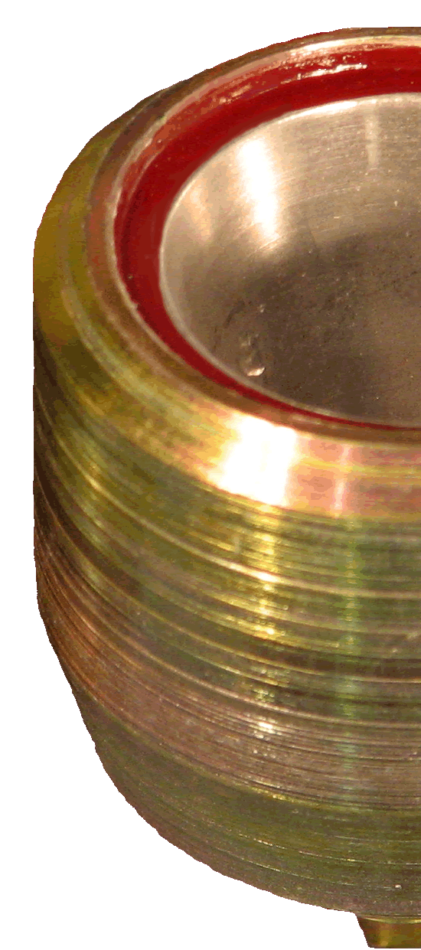
Perforating Simplifications
“Perforating is much more complex than we wish it was.”
We want:
Inexpensive and Repeatable Testing
Simple Translation to Field Performance
Predictive Software Models
Simple Tunnel Geometry for Analysis
Low Cost, High Performance

Slide 45
Perforating Simplifications
Testing Simplifications
Unstressed Manufactured Target
Translation to Field based on Stress Ratio
Consequences
Charge Performance can Reverse
Many Good Designs Overlooked
OVERPREDICTION as we compete

Slide 46
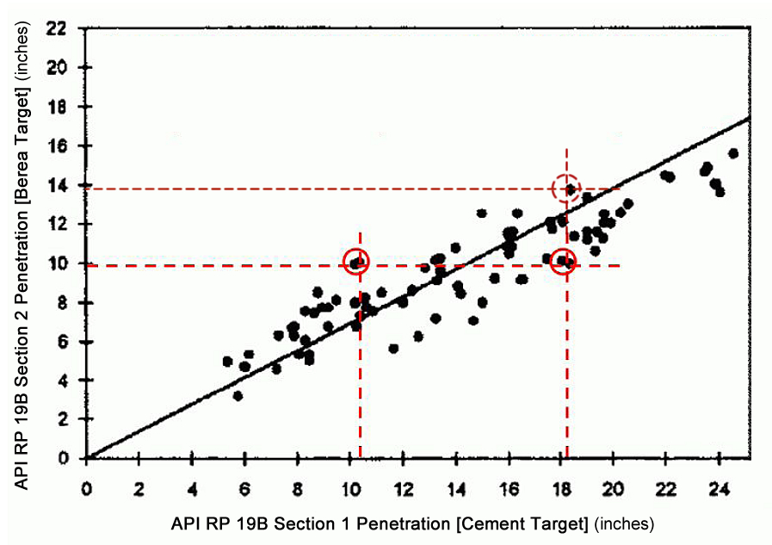
Reversed Charge Performance
Figure from SPE 27424, Ott, R.E. et al., “Simple Method Predicts Downhole Shaped-Charge Gun Performance.” Nov 1994

Slide 47
Industry Agreement – Over Prediction
SPE 124783 “Predicting Depth of Penetration of Downhole Perforators”, Gladkikh et al, Baker
SPE 125020 “A Survey of Industry Models for Perforator Performance: Suggestions for Improvement”, Behrmann et al, Schlumberger
SPE 127920 “New Predictive Model of Penetration Depth for Oilwell-Perforating Shaped Charges”, Harvey et al, Schlumberger
“The primary conclusions of this work include: (1) historical penetration models tend to over predict penetration at downhole penetrations … partly due to the industry’s continued reliance on performance into surface targets.”
---SPE125020

Slide 48
Introduction • Reactive Perforating
Using reactive materials to enhance shaped charge effectiveness
Liner material
modified to incorporate reactive materials
Case Material
Unchanged
Explosive Load
Unchanged
External Geometry
Unchanged

Slide 49
Reactive Perforating
Designed for improved tunnel geometry
Intermetallic reaction between charge liner materials, triggered by detonation pressure
Exothermic reaction
  Heats tunnel volume & near-tunnel pore space
  Consumes supporting liner material
Breaks up and expels debris from tunnel
Effect occurs in each tunnel, independently
Clean tunnels with less reliance on surge

Slide 50
Laboratory Evaluation
More than 1,000 stressed rock test shots
  “In the spirit of” API RP 19-B, Sections 2 & 4
Sandstones, carbonates, others
Wide range of stress states & configurations
Comparative testing to conventional charges
Evaluating:
  Perforation geometry and clean-up
  Relative flow performance (Section 4 type tests only)

Slide 51
Laboratory Evaluation • Example Results
Charge | Rock | Effective Stress | UB | Δ Clear Tunnel | Δ Lab Productivity
22.7g | 11,000psi SSt | 4,000psi | 1500psi | +216% | n.a.
39g | 11,000psi SSt | 5,000psi | Balanced | +82% | n.a.
25g | 5,000psi SSt | 3,000psi | Balanced | +235% | +25%
25g | 7,000psi SSt | 4,000psi | 500psi | +80% | +28%
6.8g | 10,000psi SSt | 4,000psi | Balanced | +35% | n.a.
Note of Caution: Lab tests are generally conservative. Significantly greater productivity improvements are being reported in the field.

Slide 52
Field Applications • Shoot and Produce
Wells in which no stimulation is required
Success = increased productivity
Bonus = reduced cost, complexity, risk
  Eliminate underbalance, release rig (TCP to W/L)
Examples:
  Thailand • +50% initial productivity based on performance of appraisal wells perforated with premium system
  Pakistan • 3x productivity of previous best-in-field well
  North Sea • Equivalent productivity with 1 run vs. 3 runs

Slide 53
Field Applications • Re-Perforation
Generally a tough task for perforators
  Effective stress increases as reservoir pressure drops
  Hard to apply underbalance with open perforations etc.
Success = increased productivity
Examples:
  UK • 30x productivity after re-perforation (best in field)
  USA • 10x productivity … more than 2x the increase seen re-perforating offset wells with conventional systems
  USA • 10x increase in gas well production after re-perforation … already shot twice with premium DP system

Slide 54
Field Applications • Prior to Stimulation
Success = reduced pressure, increased rate, improved reliability
Bonus = eliminate acid, avoid cleanouts
Examples:
  USA • 30-70% reduction in fracture initiation pressure (Barnett, Fayetteville, Marcellus…)
  Canada • Reduced perforation friction, negligible tortuosity, eliminate need for acid spear
  USA • 30% increase in initial productivity as result of 10% increase in treating rate at same pumping pressure

Slide 55
Field Applications • Limited Entry
Success = consistent, predictable outflow area for injectant distribution along wellbore
Bonus = eliminate rig-based breakdowns
Examples:
  Canada • Controlled EHD perforator for steam injection
  Oman • Controlled EHD perforator under development for steam injection – assurance of clean tunnels will eliminate current practice of breaking down each set of holes using straddle packer assembly on drill pipe

Slide 56
Field Applications • Unconsolidated Rock
Success = reduce TSS at same/higher rate due to greater number of open tunnels and reduced flux rate
Example:
  Oman • Well produced 2x gross liquids of comparable offsets (unfortunately mostly water…) but only 10% of the field average sand rate

